Slide 1
Fundamentals of Java Programs, Input/Output, Variables, and Arithmetic
Java™ How to Program, 10/e
Late Objects Version

Slide 2
References & Reading
The content is mainly selected (sometimes modified) from the original slides provided by the authors of the textbook
Readings
Chapter 2: Introduction to Java Applications; Input/Output and Operators
Chapter 3: Control Statements: Part I; Assignment, ++ and -- Operators

Slide 3
Outline
2.1 Introduction
2.2 Your First Program in Java: Printing a Line of Text
2.3 Modifying Your First Java Program
2.4 Displaying Text with printf
2.5 Another Application: Adding Integers
2.6 Memory Concepts
2.7 Arithmetic
3.11 Compound Assignment Operators
3.12 Increment and Decrement Operators

Slide 4
2.1 Introduction
Java application programming
Java application: a computer program that executes when you use the java command to launch the Java Virtual Machine (JVM).
Use tools from the JDK to compile and run programs.
Videos at www.deitel.com/books/jhtp10/
Help you get started with Eclipse, NetBeans and IntelliJ IDEA integrated development environments.

Slide 5
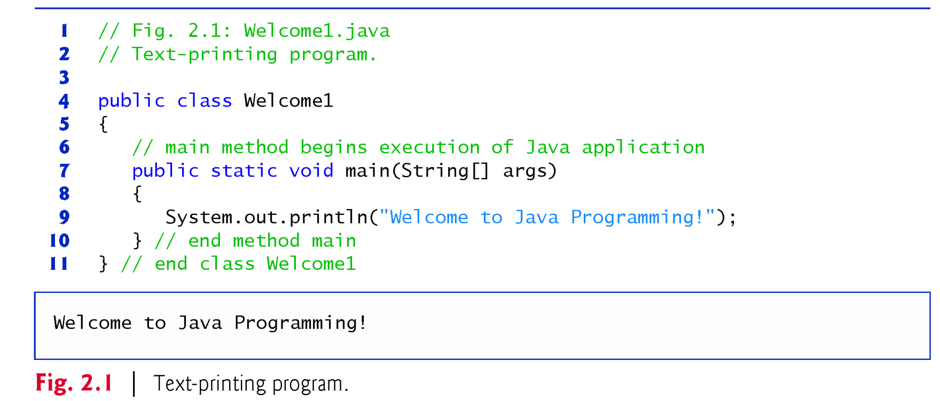
2.2 Your First Program in Java: Printing a Line of Text

Slide 6
2.2 Your First Program in Java: Printing a Line of Text (Cont.)
Commenting Your Programs
Comments
// Fig. 2.1: Welcome1.java
// indicates that the line is a comment.
Used to document programs and improve their readability.
Compiler ignores comments.
A comment that begins with // is an end-of-line comment—it terminates at the end of the line on which it appears.
Traditional comment, can be spread over several lines as in
/* This is a traditional comment. It can be split over multiple lines */
This type of comment begins with /* and ends with */.
All text between the delimiters is ignored by the compiler.

Slide 7
2.2 Your First Program in Java: Printing a Line of Text (Cont.)
Javadoc comments
Delimited by /** and */.
All text between the Javadoc comment delimiters is ignored by the compiler.
Enable you to embed program documentation directly in your programs.
The javadoc utility program (online Appendix G) reads Javadoc comments and uses them to prepare program documentation in HTML format.

Slide 8
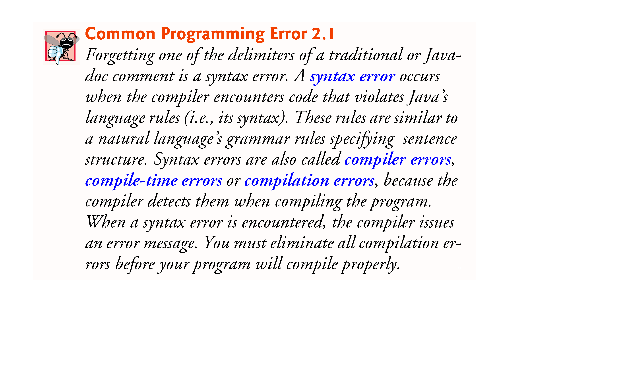

Slide 9
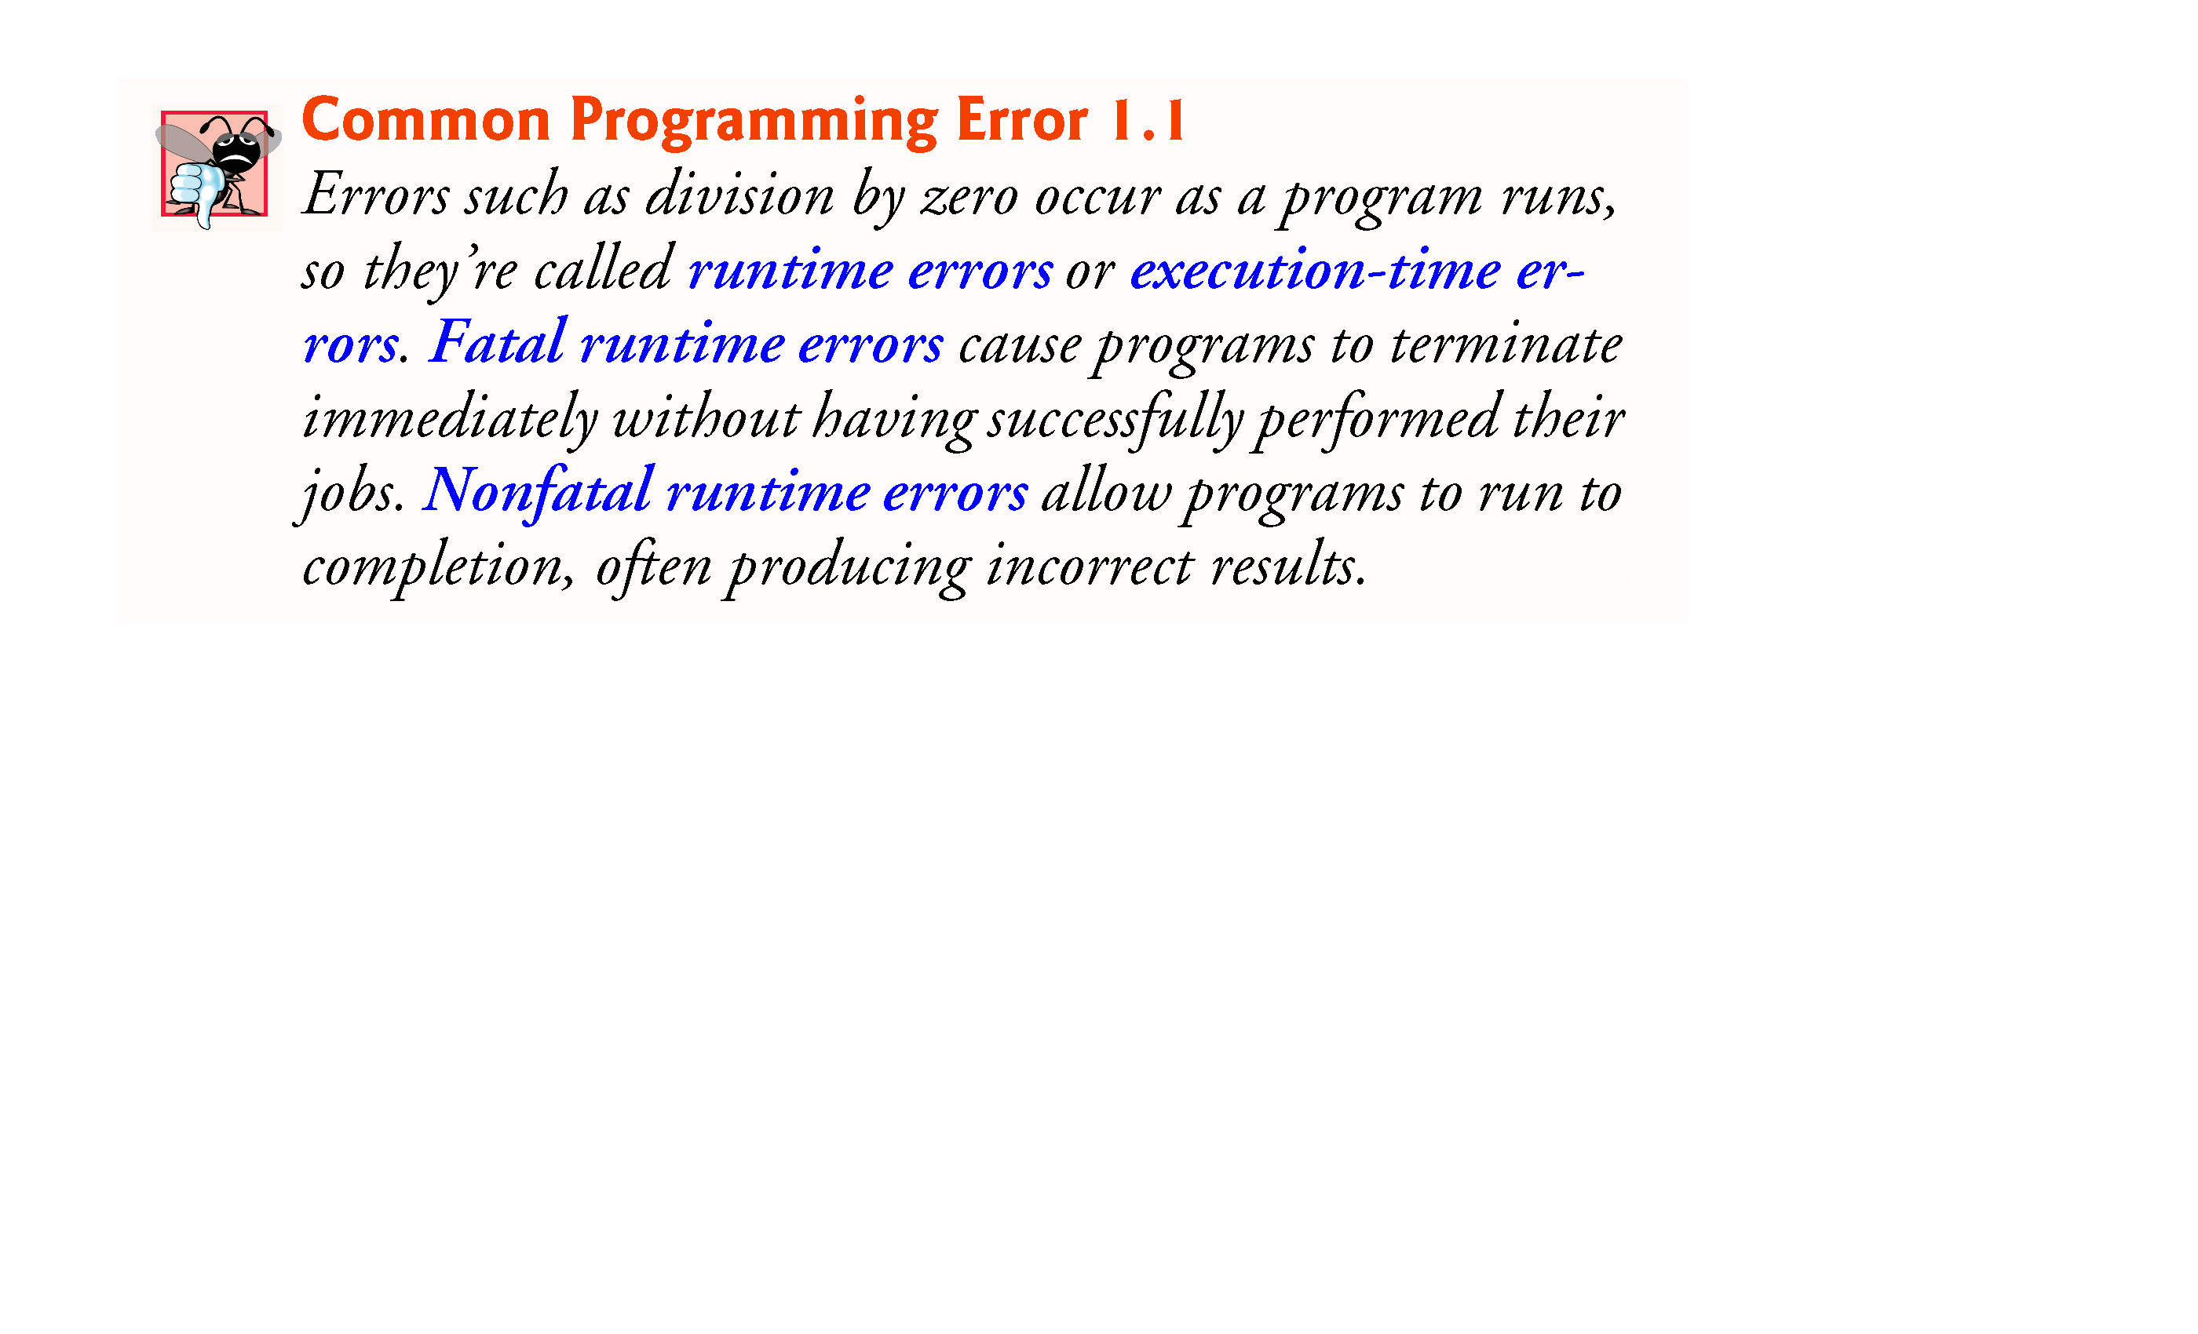
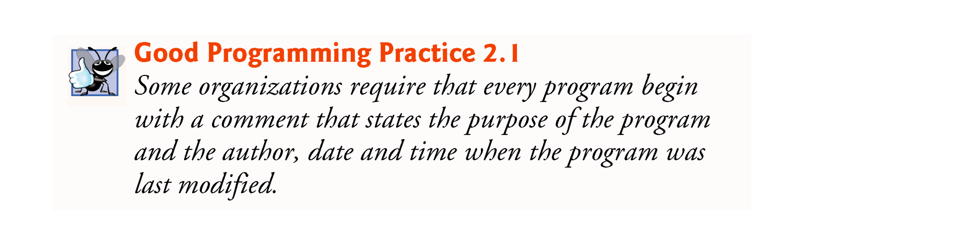

Slide 10
2.2 Your First Program in Java: Printing a Line of Text (Cont.)
Using Blank Lines
Blank lines, space characters and tabs
Make programs easier to read.
Together, they’re known as white space (or whitespace).
White space is ignored by the compiler.

Slide 11
2.2 Your First Program in Java: Printing a Line of Text (Cont.)
Declaring a class
Class declaration
public class Welcome1
Every Java program consists of at least one class that you define.
class keyword introduces a class declaration and is immediately followed by the class name.
Keywords (Appendix C) are reserved for use by Java and are always spelled with all lowercase letters.

Slide 12
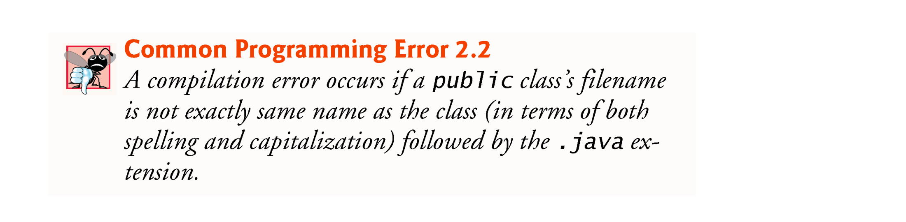
2.2 Your First Program in Java: Printing a Line of Text (Cont.)
Filename for a public Class
A public class must be placed in a file that has a filename of the form ClassName.java, so class Welcome1 is stored in the file Welcome1.java.

Slide 13
2.2 Your First Program in Java: Printing a Line of Text (Cont.)
Class Names and Identifiers
By convention, begin with a capital letter and capitalize the first letter of each word they include (e.g., SampleClassName).
A class name is an identifier—a series of characters consisting of letters, digits, underscores (_) and dollar signs ($) that does not begin with a digit and does not contain spaces.
Java is case sensitive—uppercase and lowercase letters are distinct—so a1 and A1 are different (but both valid) identifiers.

Slide 14
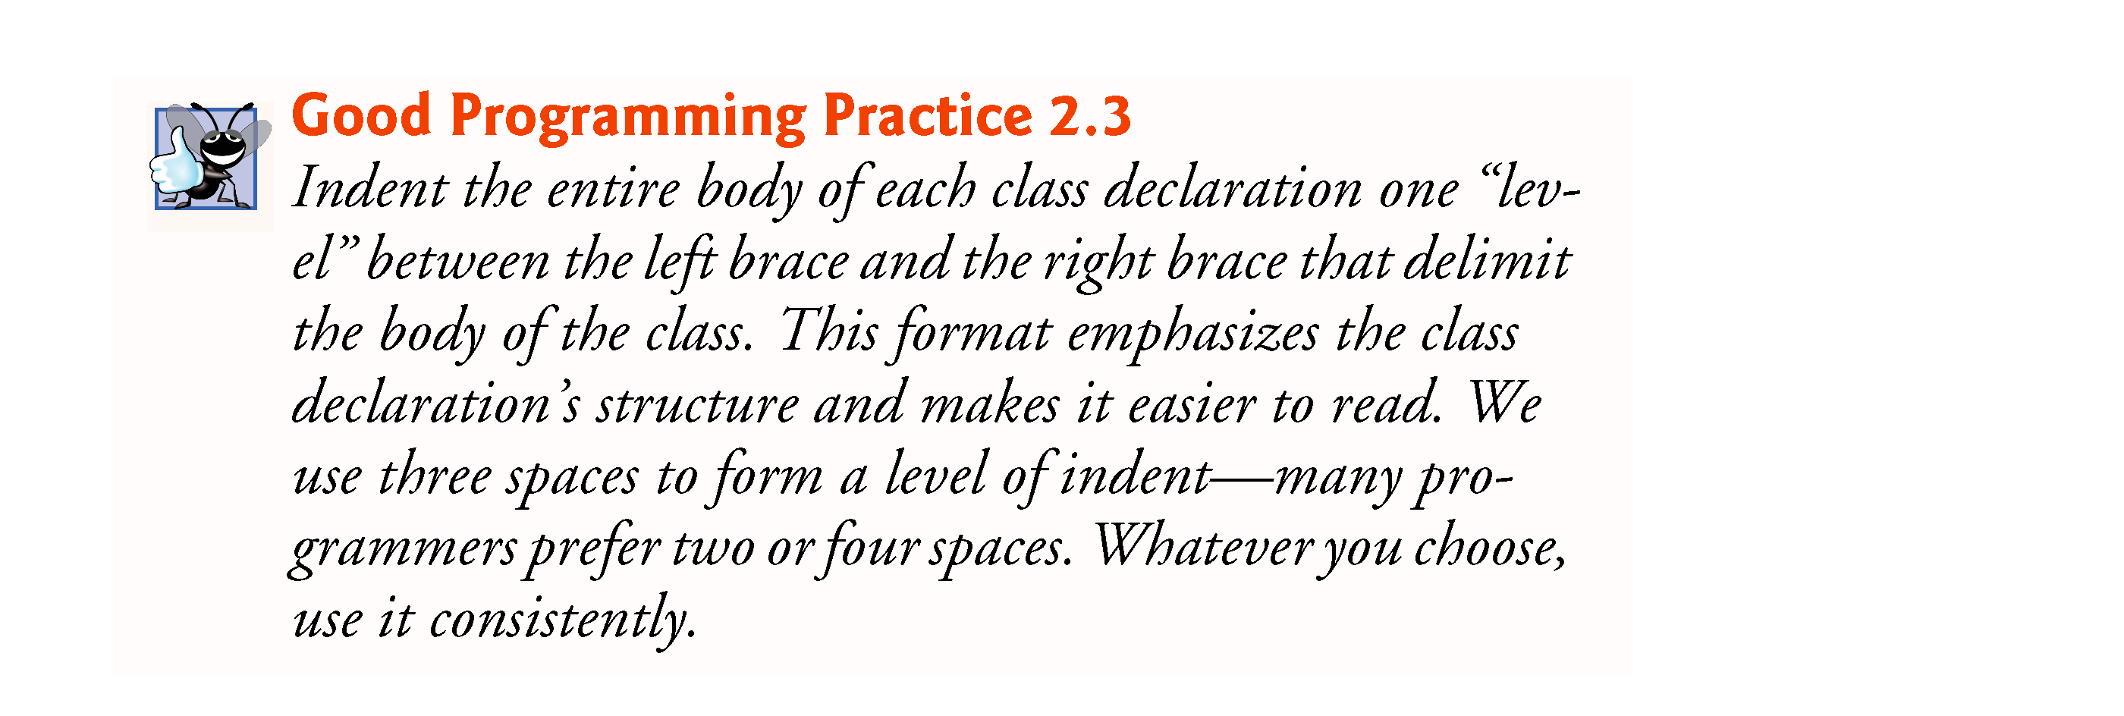
2.2 Your First Program in Java: Printing a Line of Text (Cont.)
Class Body
A left brace, {, begins the body of every class declaration.
A corresponding right brace, }, must end each class declaration.

Slide 15
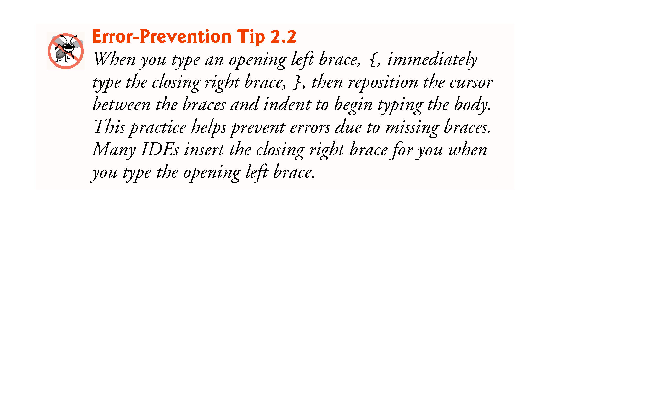
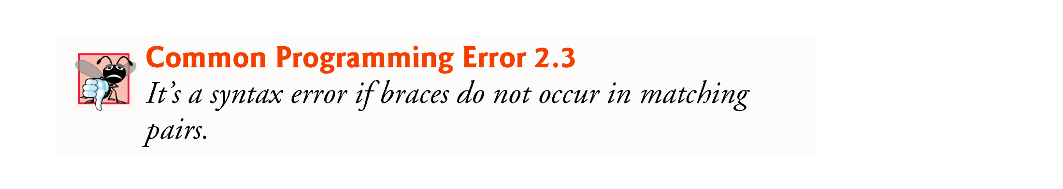


Slide 16
2.2 Your First Program in Java: Printing a Line of Text (Cont.)
Declaring a Method
public static void main( String[] args )
Starting point of every Java application.
Parentheses after the identifier main indicate that it’s a program building block called a method.
Java class declarations normally contain one or more methods.
main must be defined as shown; otherwise, the JVM will not execute the application.
Methods perform tasks and can return information when they complete their tasks.
Keyword void indicates that this method will not return any information.

Slide 17
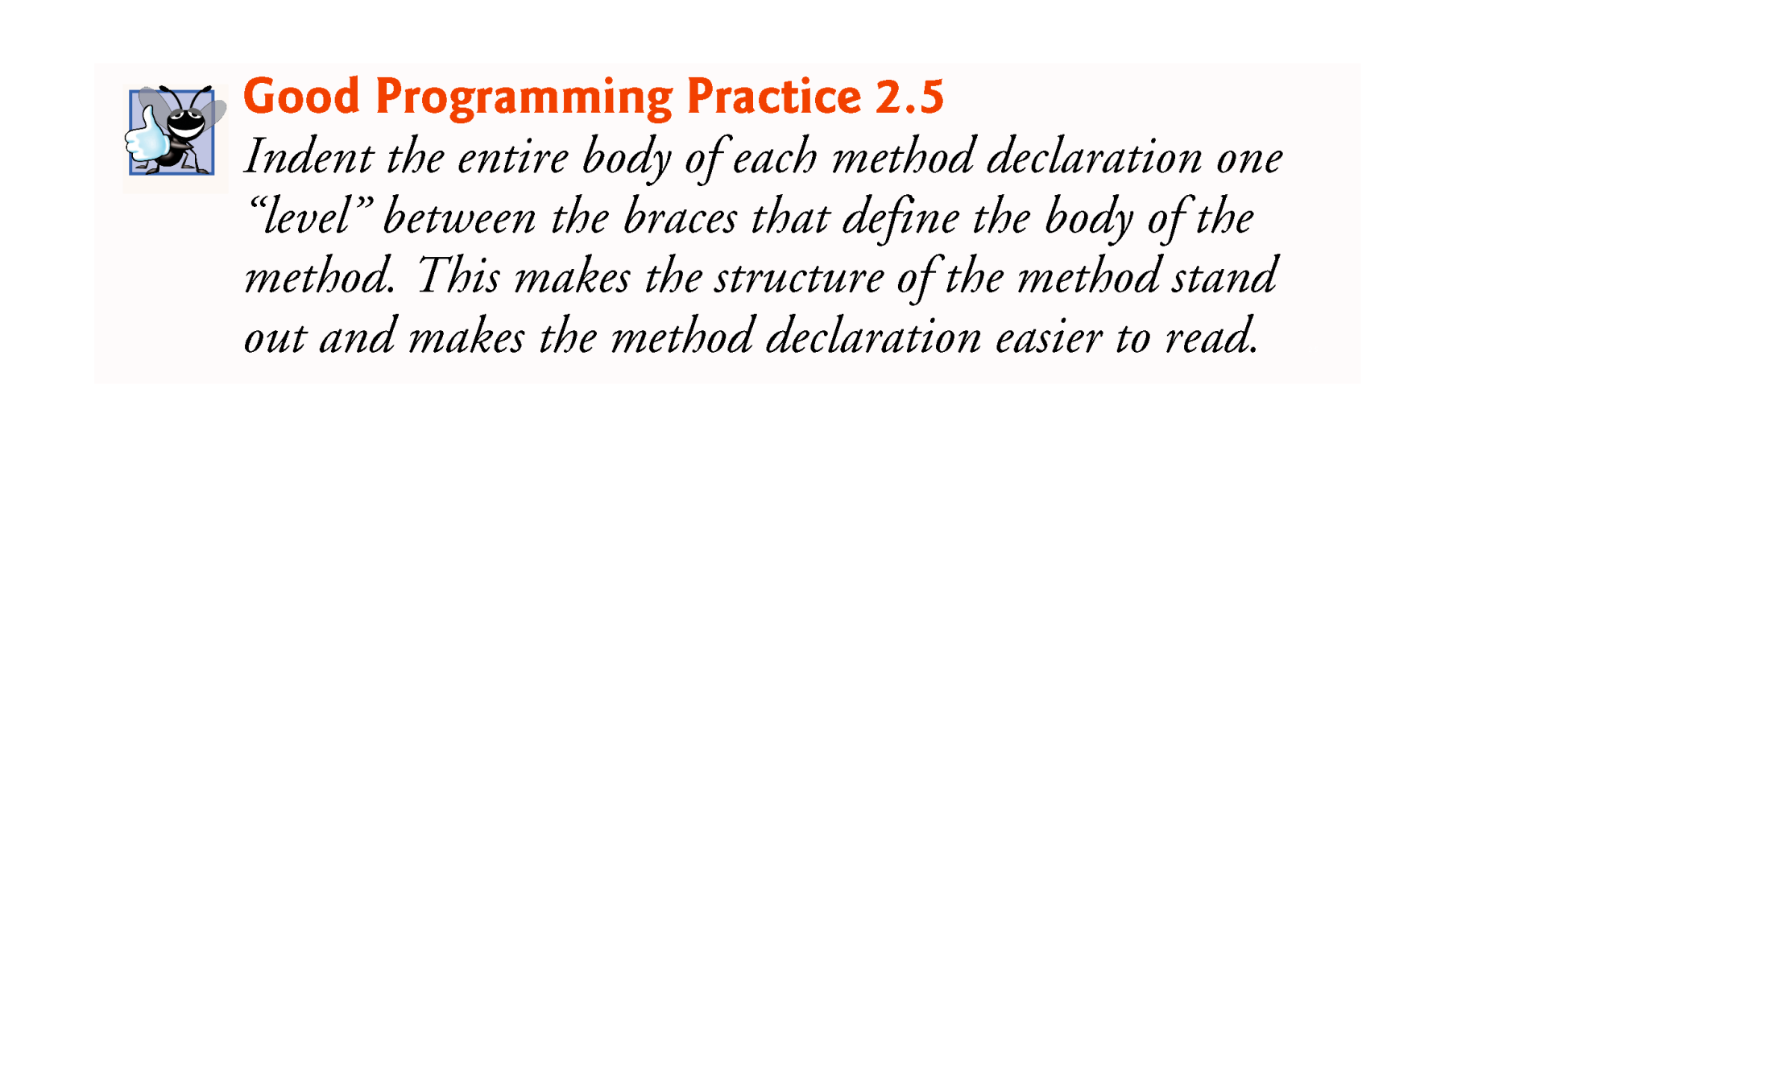

Slide 18
2.2 Your First Program in Java: Printing a Line of Text (Cont.)
Body of the method declaration
Enclosed in left and right braces.
Statement
System.out.println("Welcome to Java Programming!");
Instructs the computer to perform an action
Display the characters contained between the double quotation marks.
Together, the quotation marks and the characters between them are a string—also known as a character string or a string literal.
White-space characters in strings are not ignored by the compiler.
Strings cannot span multiple lines of code.

Slide 19
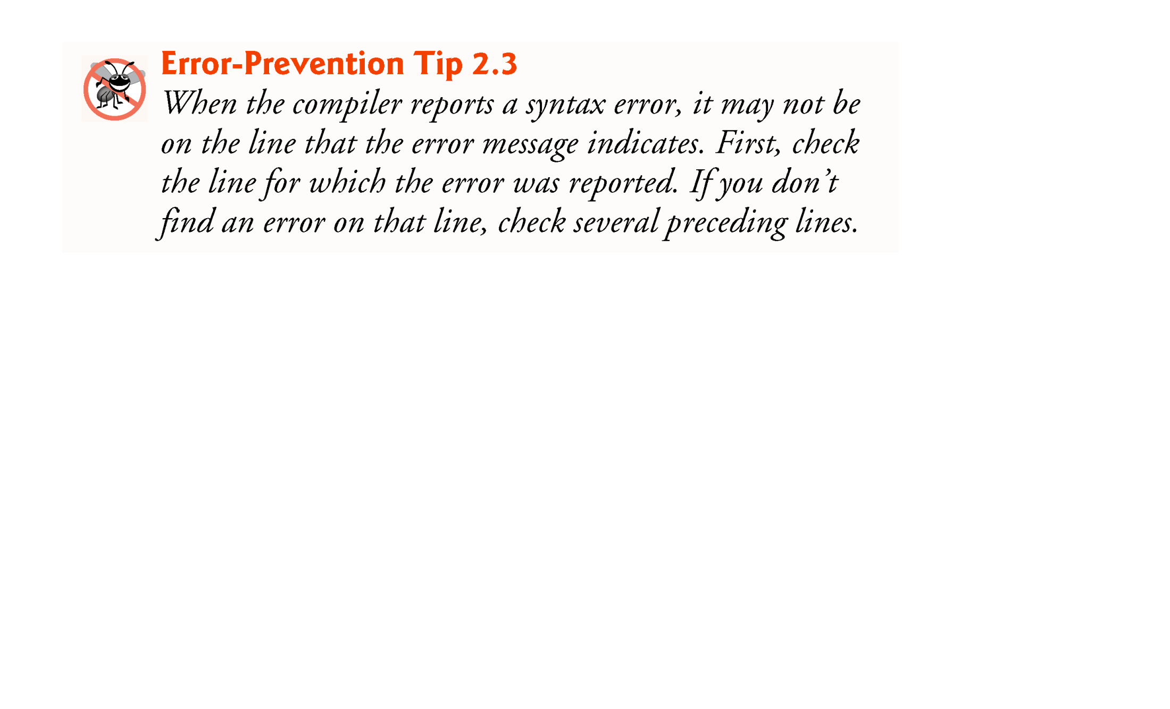

Slide 20
2.2 Your First Program in Java: Printing a Line of Text (Cont.)
System.out object
Standard output object.
Allows a Java application to display information in the command window from which it executes.
System.out.println method
Displays (or prints) a line of text in the command window.
The string in the parentheses the argument to the method.
Positions the output cursor at the beginning of the next line in the command window.
Most statements end with a semicolon.

Slide 21
2.3 Modifying Your First Java Program
Class Welcome2, shown in Fig. 2.3, uses two statements to produce the same output as that shown in Fig. 2.1.
System.out’s method print displays a string.
Unlike println, print does not position the output cursor at the beginning of the next line in the command window.
The next character the program displays will appear immediately after the last character that print displays.

Slide 22
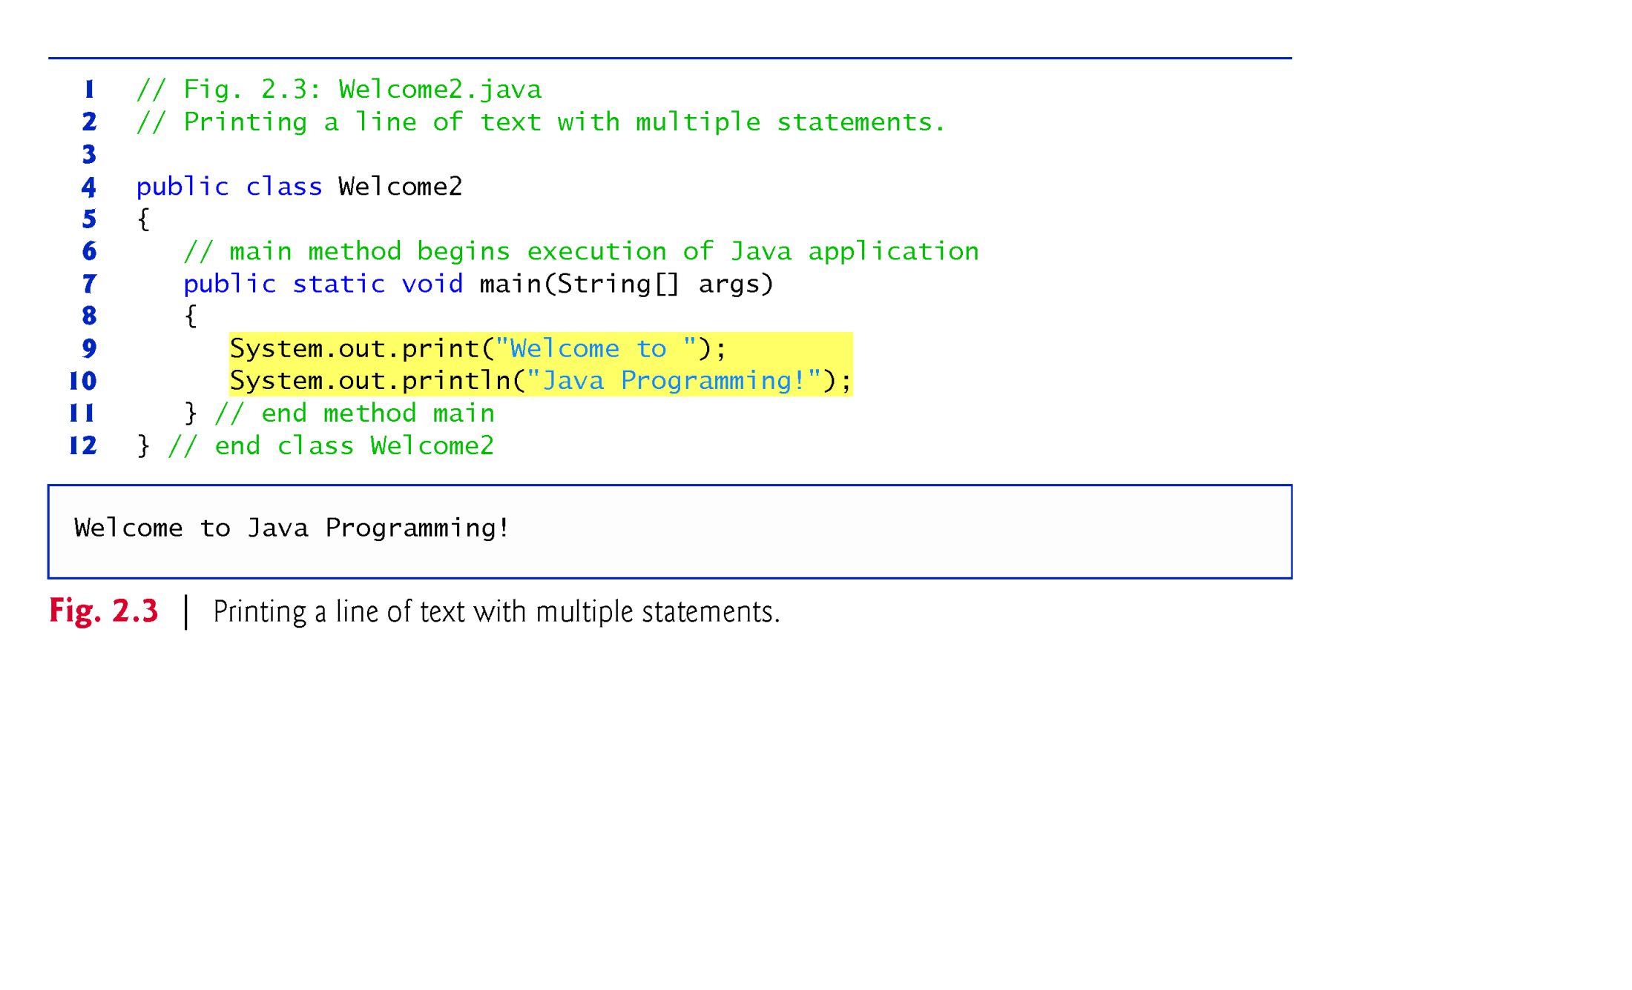

Slide 23
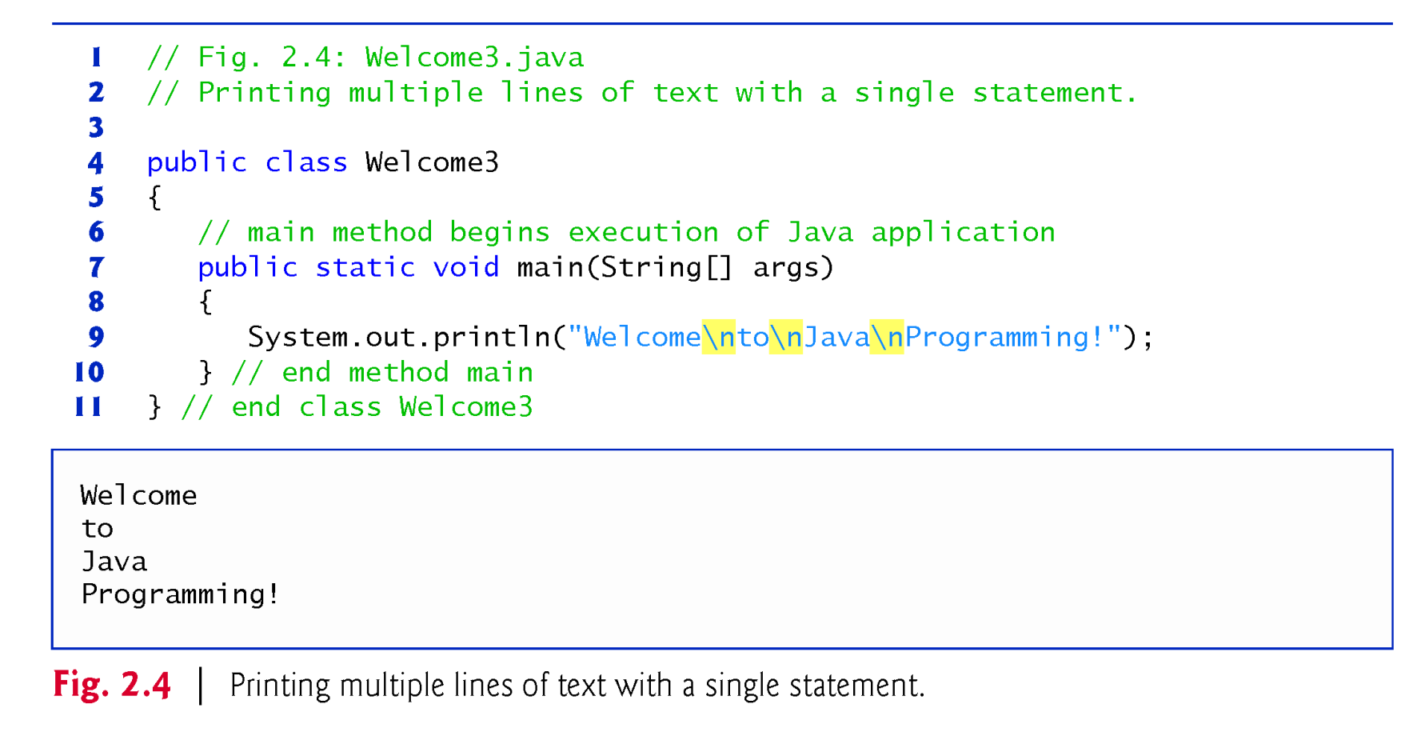
2.3 Modifying Your First Java Program (Cont.)
The backslash (\) is called an escape character.
Indicates a “special character”
Backslash is combined with the next character to form an escape sequence—\n represents the newline character.

Slide 24
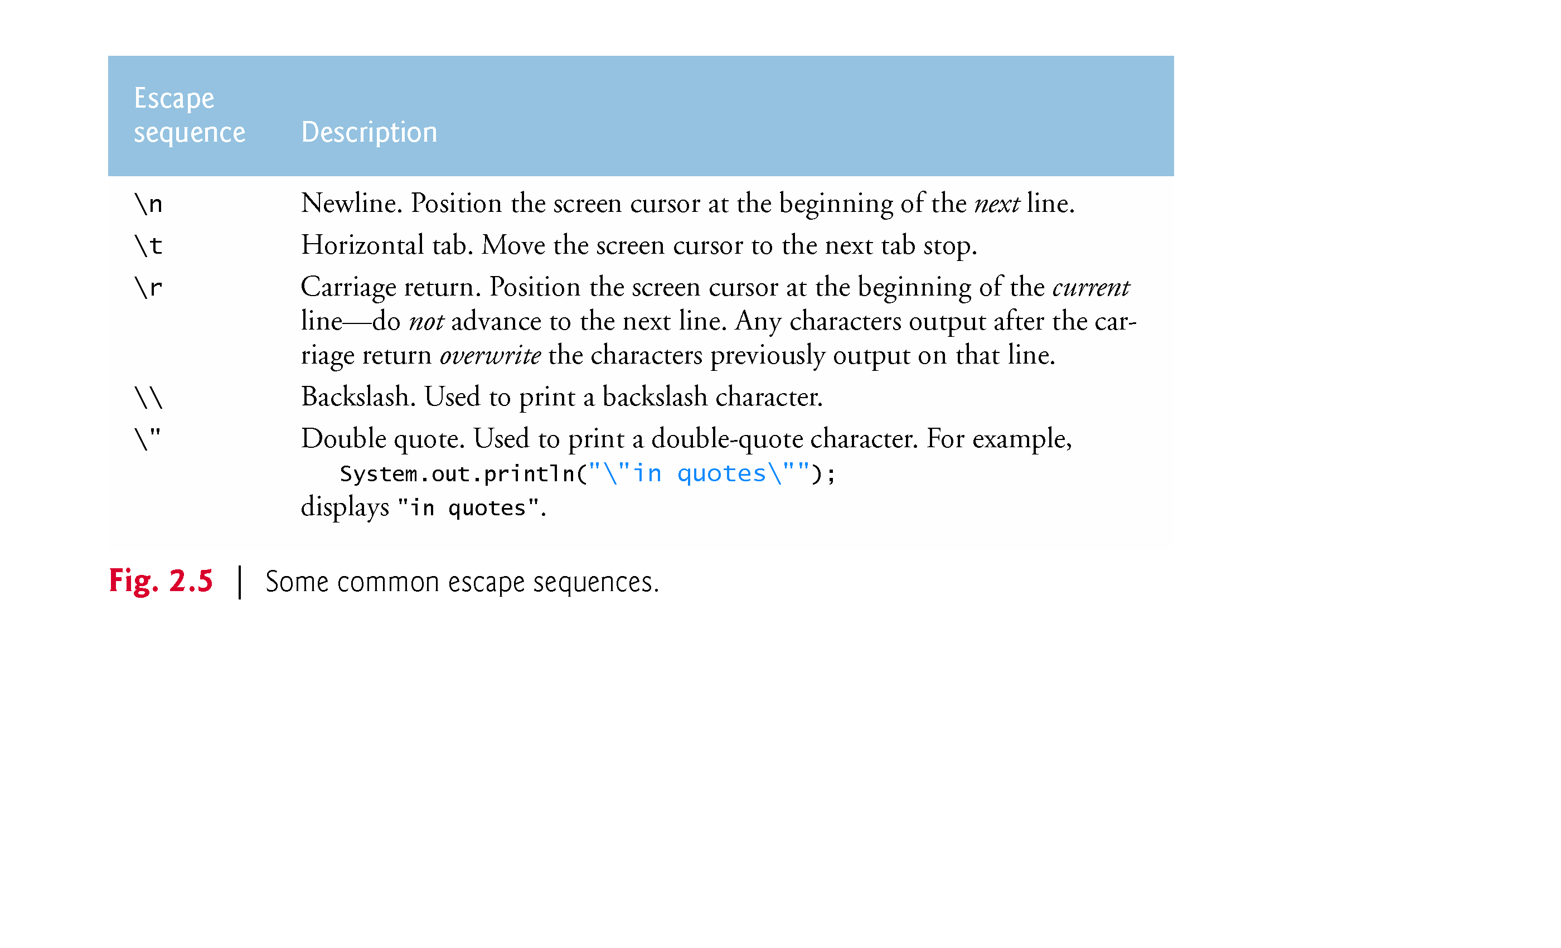

Slide 25
2.4 Displaying Text with printf
System.out.printf method
f means “formatted”
displays formatted data
Multiple method arguments are placed in a comma-separated list.
Calling a method is also referred to as invoking a method.
Java allows large statements to be split over many lines.
Cannot split a statement in the middle of an identifier or string.
Method printf’s first argument is a format string
May consist of fixed text and format specifiers.
Fixed text is output as it would be by print or println.
Each format specifier is a placeholder for a value and specifies the type of data to output.
Format specifiers begin with a percent sign (%) and are followed by a character that represents the data type.
Format specifier %s is a placeholder for a string.

Slide 26
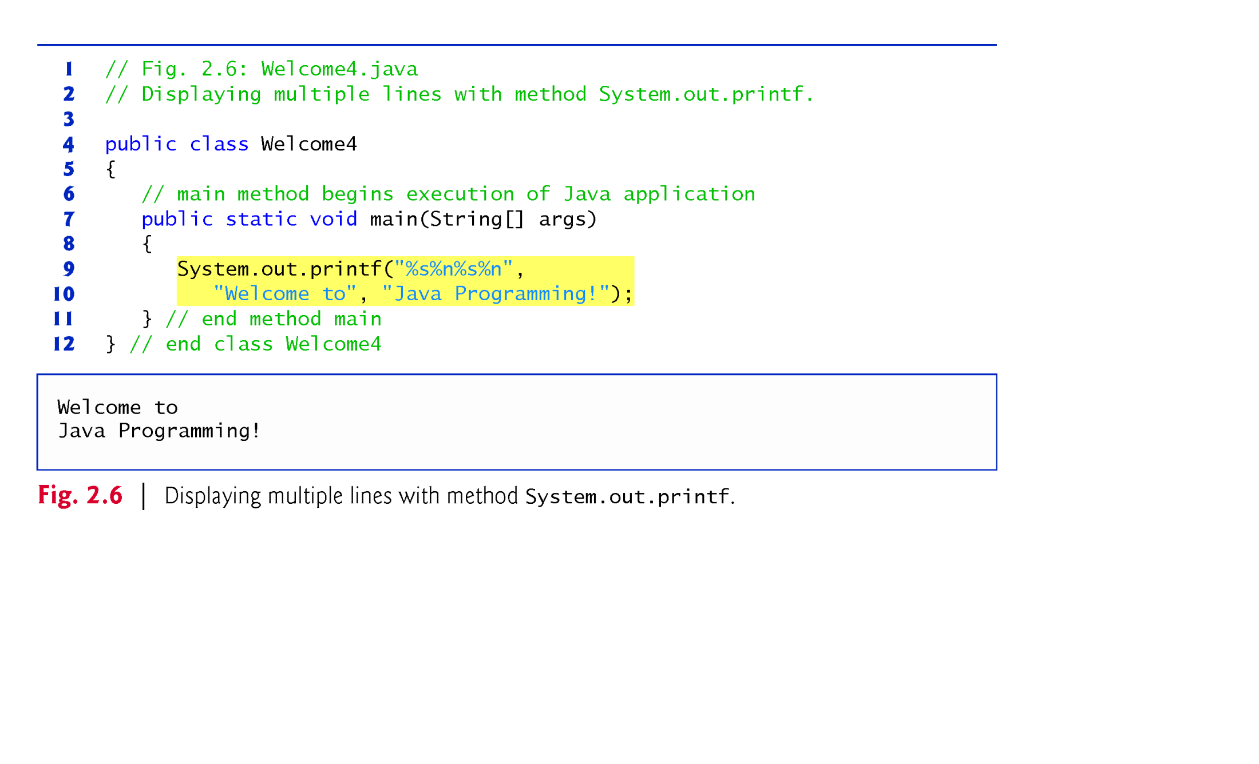

Slide 27
2.5 Another Application: Adding Integers
Integers are numbers like –22, 7, 0 and 1024
Programs remember numbers and other data in the computer’s memory and access that data through program elements called variables.
To add 2 integer numbers we need 3 variables:
The first one to store the value of the first number
The second one to store the value of the second number
The third one to store the result of the addition
We need also 2 operations:
Addition (+) a binary operator to sum the numbers
Assignment (=) a binary operator to assign the value of the result

Slide 28
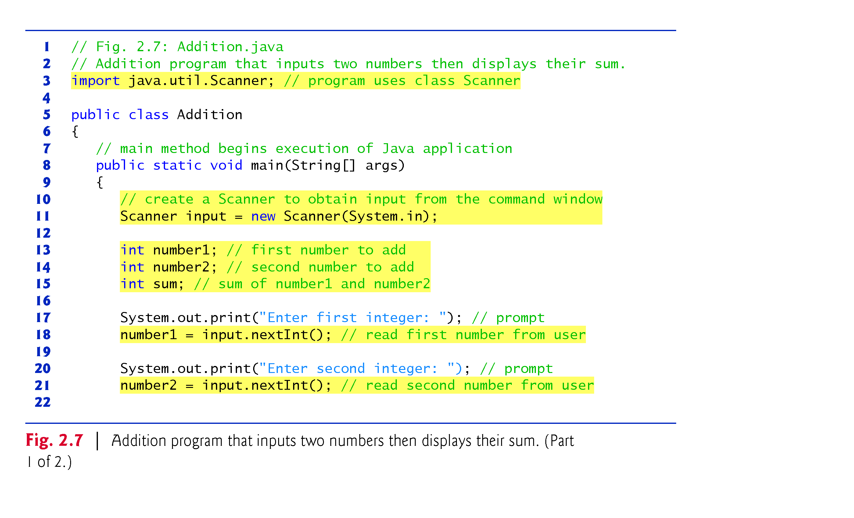
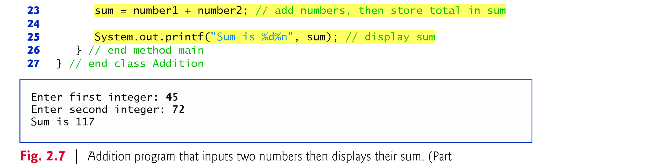

Slide 29
2.5.1 import Declarations
Helps the compiler locate a class that is used in this program.
Rich set of predefined classes that you can reuse rather than “reinventing the wheel.”
Classes are grouped into packages—named groups of related classes—and are collectively referred to as the Java class library, or the Java Application Programming Interface (Java API).
You use import declarations to identify the predefined classes used in a Java program.

Slide 30
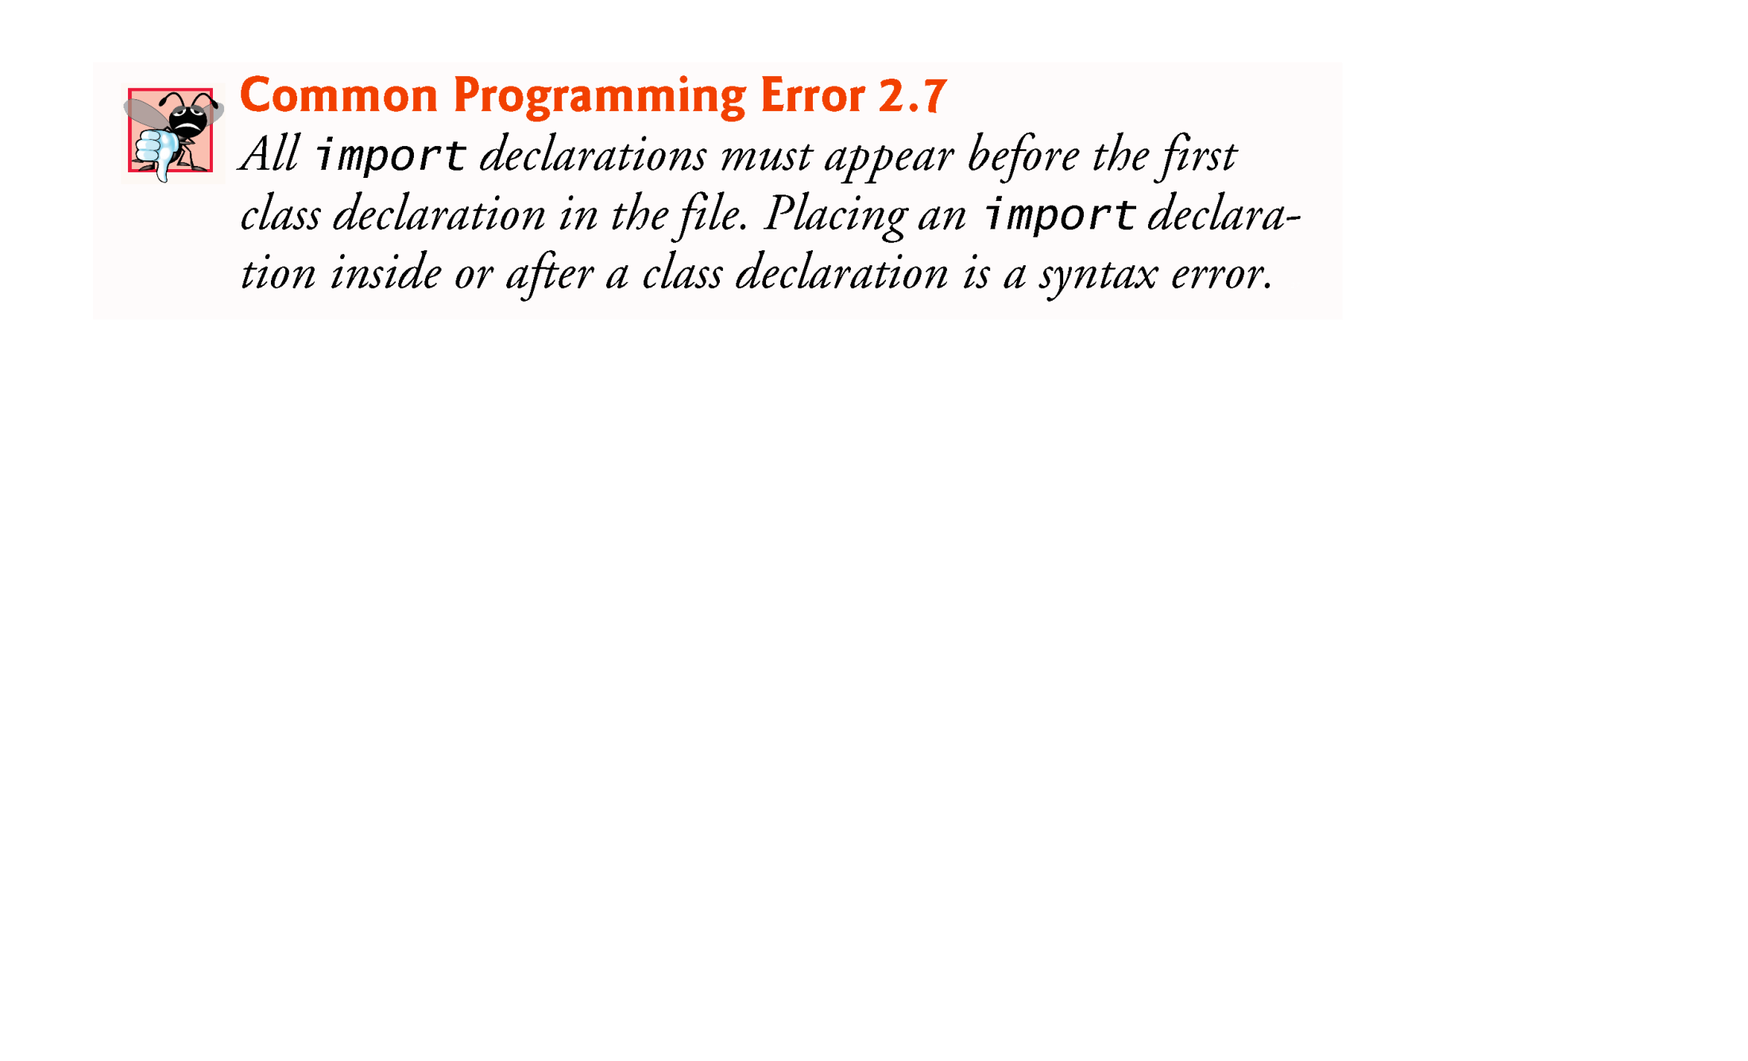
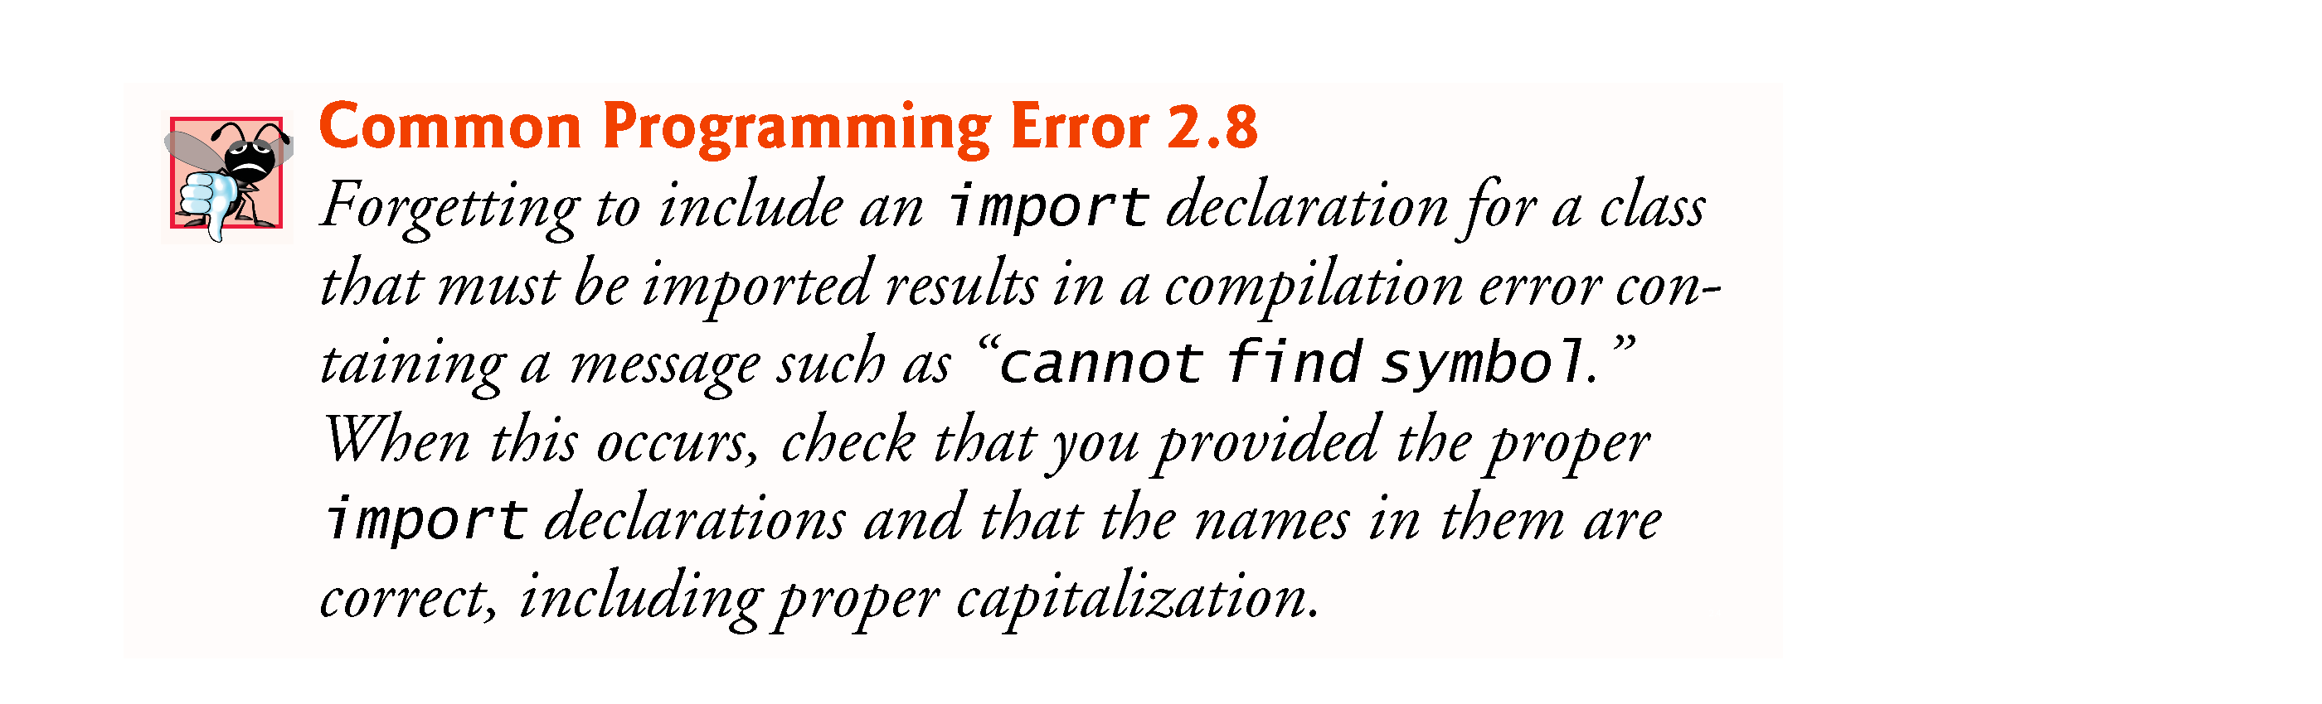

Slide 31
2.5.3 Declaring and Creating a Scanner to Obtain User Input from the Keyboard
Variable declaration statement
Scanner input = new Scanner( System.in );
Specifies the name (input) and type (Scanner) of a variable that is used in this program.
Scanner
Enables a program to read data for use in a program.
Data can come from many sources, such as the user at the keyboard or a file on disk.
Before using a Scanner, you must create it and specify the source of the data.
The new keyword creates an object (special variable).
Standard input object, System.in, enables applications to read bytes of data typed by the user.
Scanner object (variable) translates these bytes into types that can be used in a program.

Slide 32
2.5.4 Declaring Variables to Store Integers
Variable declaration statements
int number1; // first number to add int number2; // second number to add int sum; // sum of number1 and number2
declare that variables number1, number2 and sum hold data of type int
They can hold integer.
Range of values for an int is –2,147,483,648 to +2,147,483,647.
The int values you use in a program may not contain commas.
Several variables of the same type may be declared in one declaration with the variable names separated by commas.
int number1, number2, sum;

Slide 33
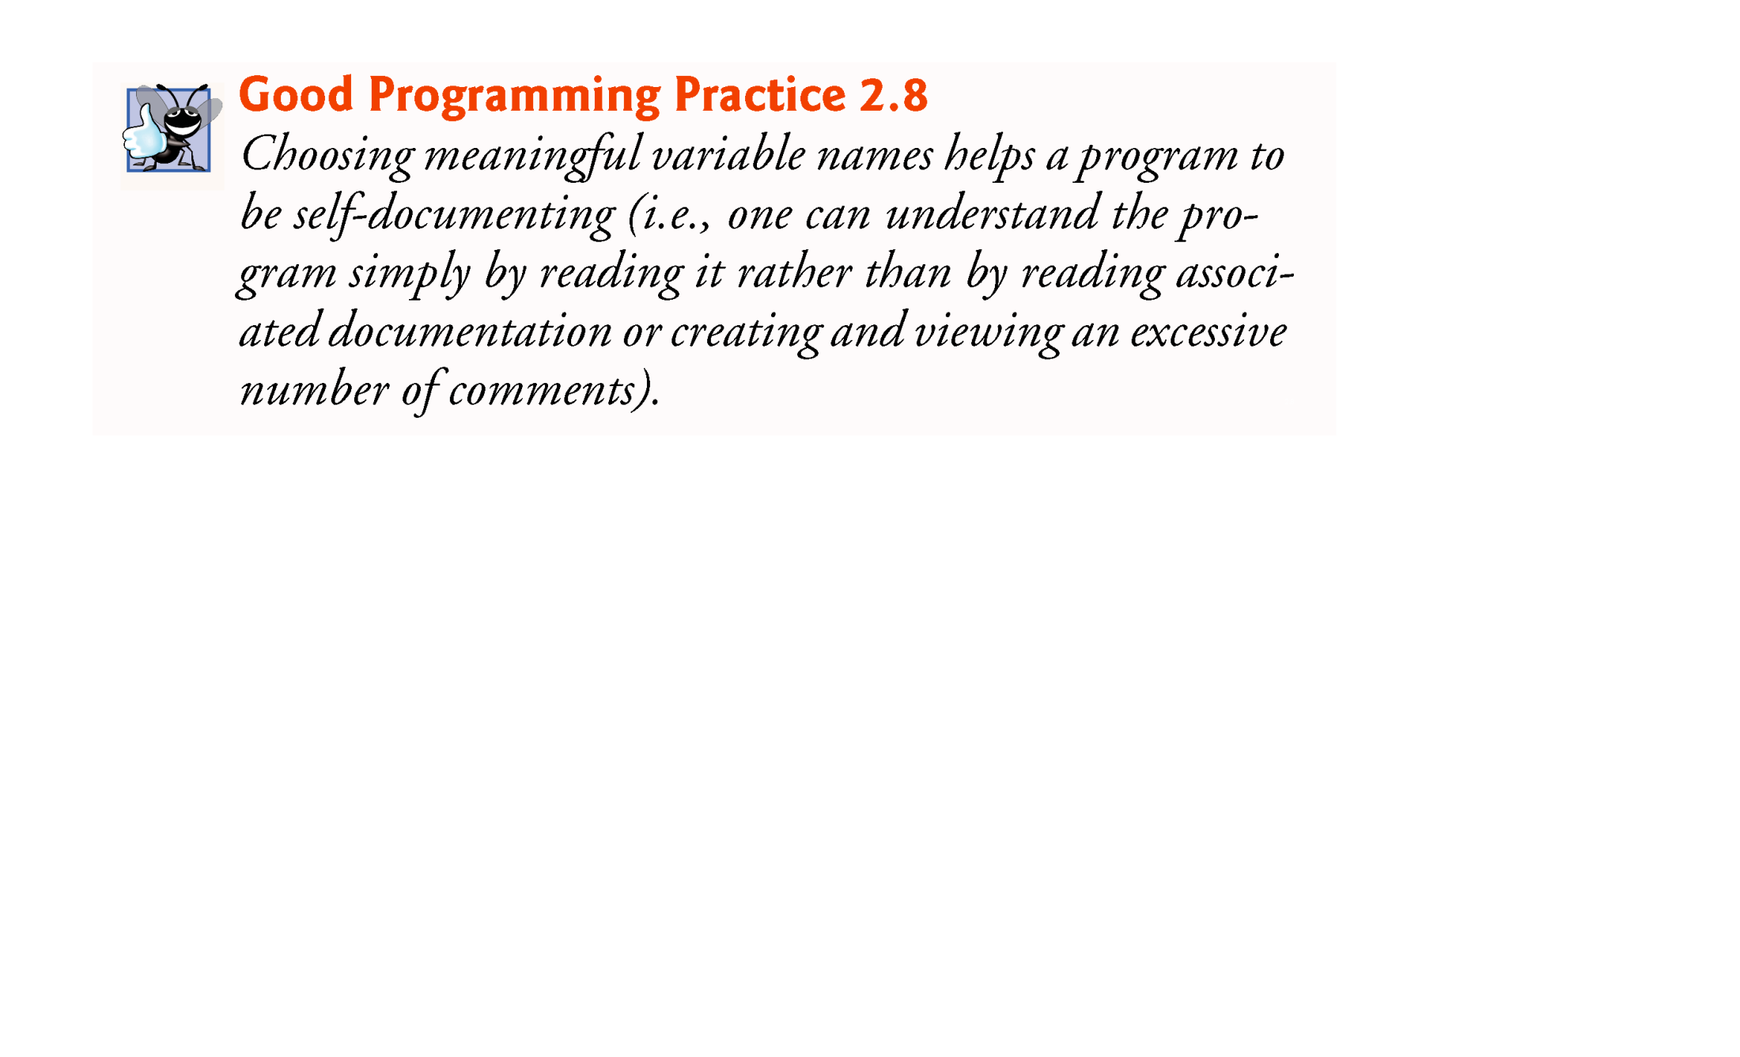
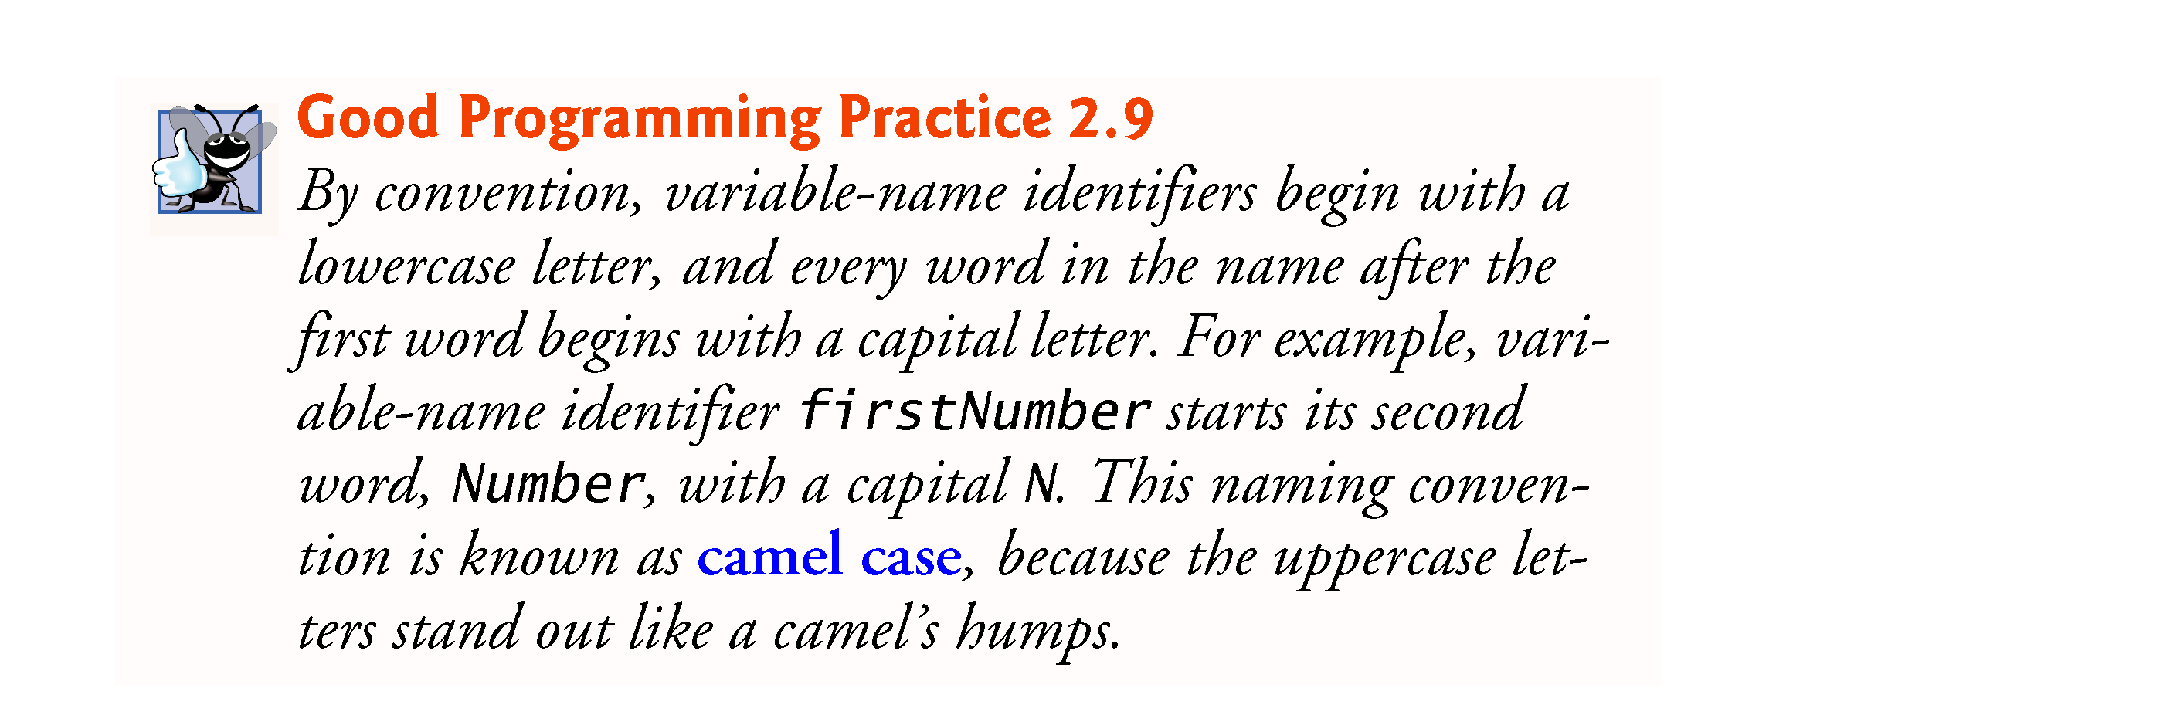

Slide 34
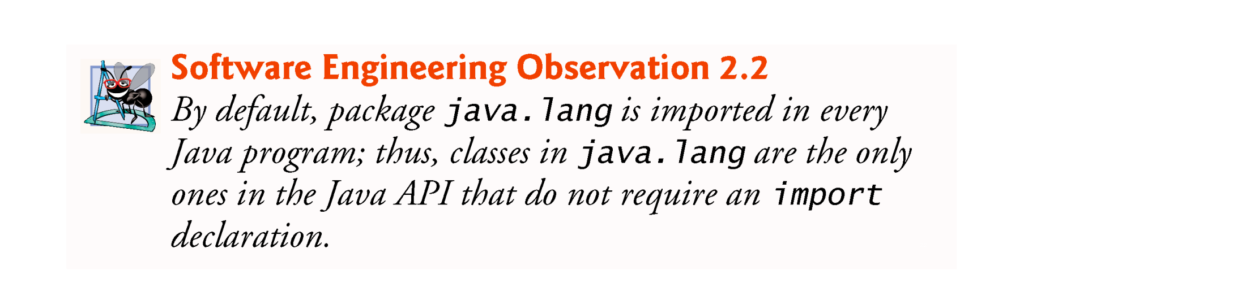
2.5.5 Prompting the User for Input
Prompt
Output statement that directs the user to take a specific action.
Class System
Part of package java.lang.
Class System is not imported with an import declaration at the beginning of the program.

Slide 35
2.5.6 Obtaining an int as Input from the User
Scanner method nextInt
number1 = input.nextInt(); // read first number from user
Obtains an integer from the user at the keyboard.
Program waits for the user to type the number and press the Enter key to submit the number to the program.
The result of the call to method nextInt is placed in variable number1 by using the assignment operator, =.
“number1 gets the value of input.nextInt().”
Operator = is called a binary operator—it has two operands.
Everything to the right of the assignment operator, =, is always evaluated before the assignment is performed.

Slide 36
2.5 Another Application: Adding Integers (Cont.)
Arithmetic
sum = number1 + number2; // add numbers then store total in sum
Assignment statement that calculates the sum of the variables number1 and number2 then assigns the result to variable sum by using the assignment operator, =.
“sum gets the value of number1 + number2.”
Portions of statements that contain calculations are called expressions.
An expression is any portion of a statement that has a value associated with it.

Slide 37
2.5.9 Displaying the Result of the Calculation
Integer formatted output
System.out.printf( "Sum is %d%n", sum );
Format specifier %d is a placeholder for an int value
The letter d stands for “decimal integer.”

Slide 38
2.6 Memory Concepts
Variables
A location in the computer’s memory where a value can be stored for use later in a program.
Every variable has a name, a type, a size (in bytes) and a value.
A variable’s name enables the program to access the value of the variable in memory.
The name can be any valid identifier.
A variable’s type specifies what kind of information is stored at that location in memory.
Must be declared with a name and a type before they can be used.
When a new value is placed into a variable, the new value replaces the previous value (if any)
The previous value is lost, so this process is said to be destructive.

Slide 39
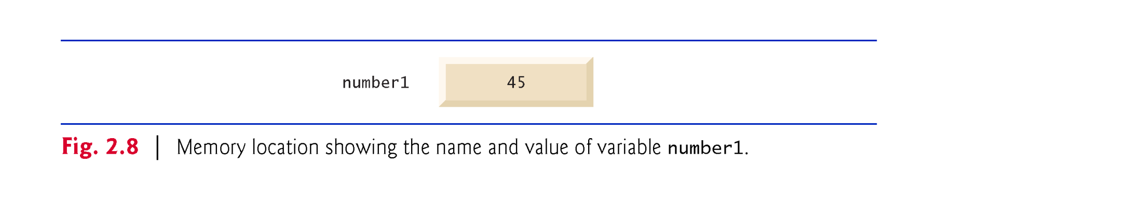
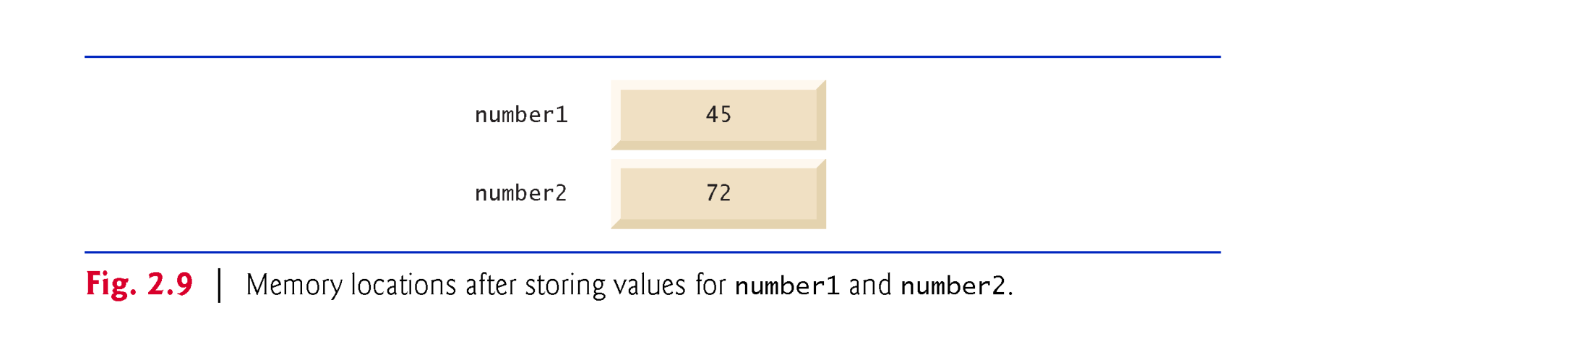
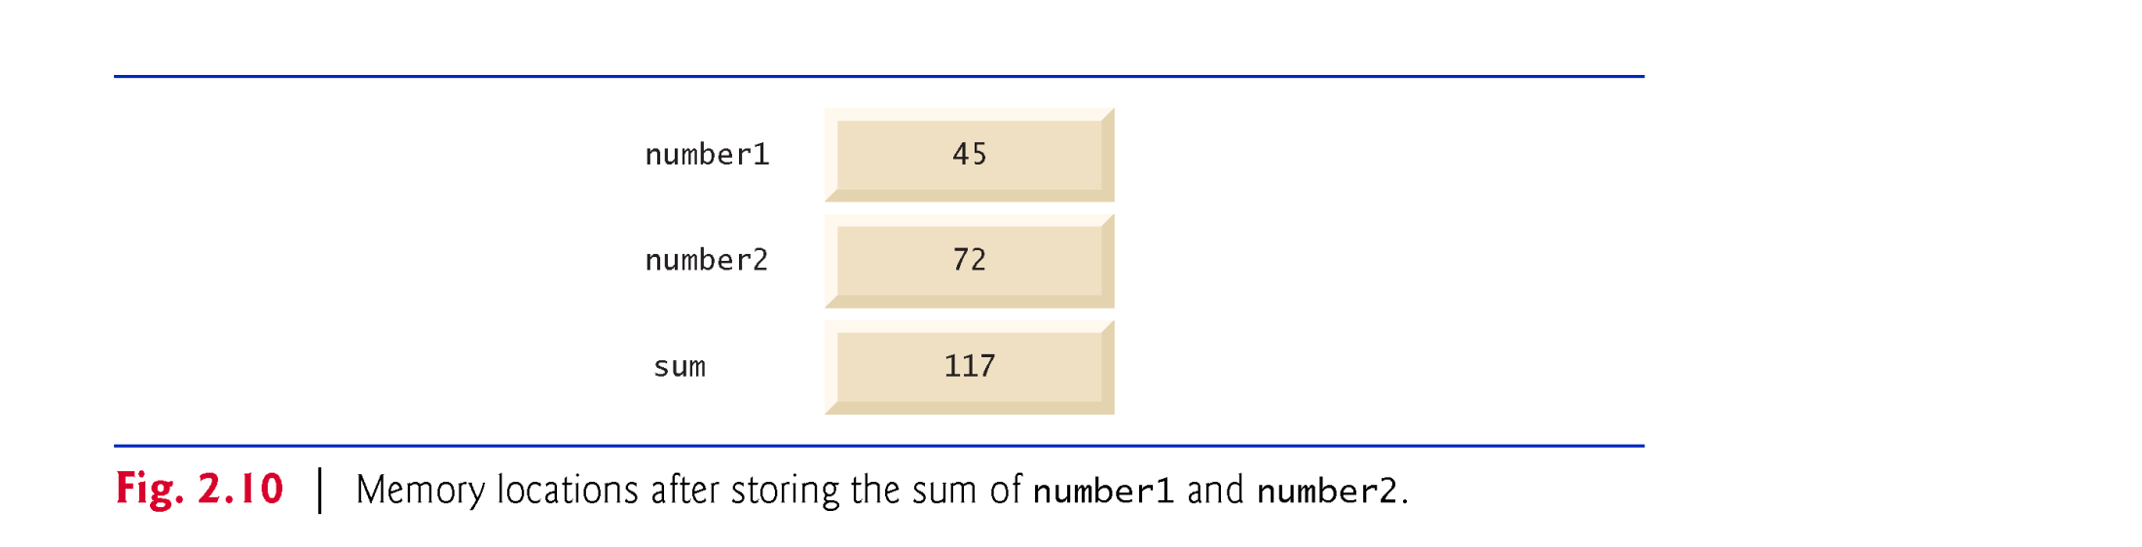

Slide 40
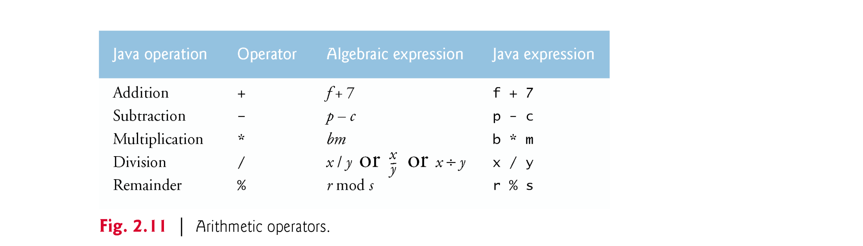
2.7 Arithmetic
The arithmetic operators are binary operators because they each operate on two operands.
Integer division yields an integer quotient.
Any fractional part in integer division is simply truncated (i.e., discarded)—no rounding occurs.
The remainder operator, %, yields the remainder after division.

Slide 41
2.7 Arithmetic (Cont.)
Arithmetic expressions in Java must be written in straight-line form to facilitate entering programs into the computer.
Expressions such as “a divided by b” must be written as a / b, so that all constants, variables and operators appear in a straight line.
Parentheses are used to group terms in expressions in the same manner as in algebraic expressions.
If an expression contains nested parentheses, the expression in the innermost set of parentheses is evaluated first.
As in algebra, it’s acceptable to place unnecessary parentheses in an expression to make the expression clearer

Slide 42
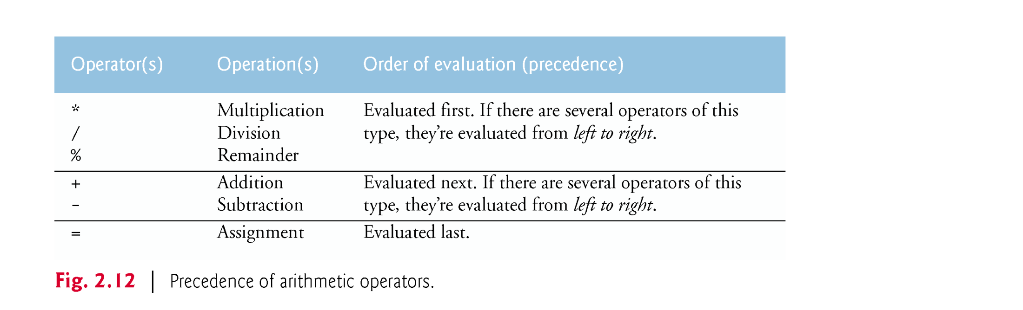
2.7 Arithmetic (Cont.)
Rules of operator precedence

Slide 43
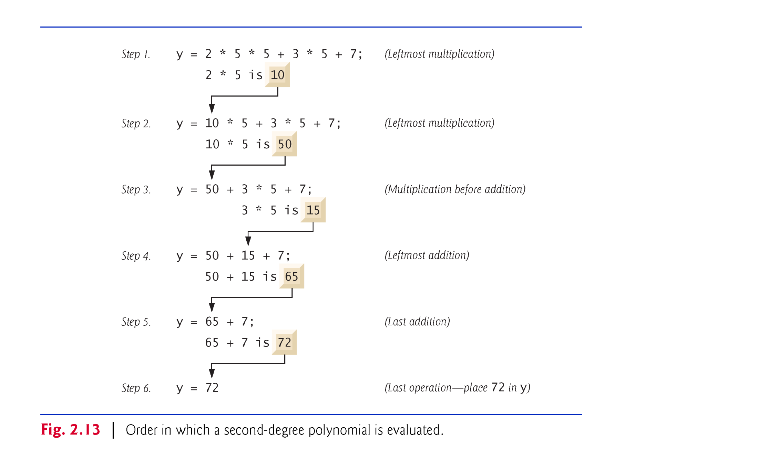

Slide 44
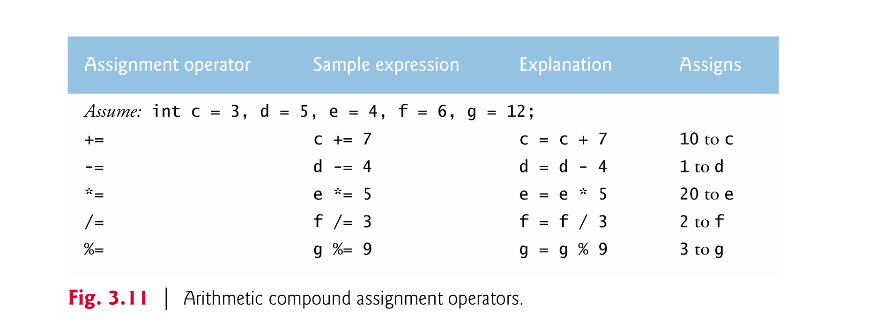
3.11 Compound Assignment Operators
Compound assignment operators abbreviate assignment expressions.
Example:
c = c + 3;
can be written with the addition compound assignment operator, +=, as
c += 3;

Slide 45
3.12 Increment and Decrement Operators
Unary increment operator, ++, adds one to its operand
Unary decrement operator, --, subtracts one from its operand
An increment or decrement operator that’s prefixed to (placed before) a variable is referred to as the prefix increment or prefix decrement operator, respectively.
An increment or decrement operator that’s postfixed to (placed after) a variable is referred to as the postfix increment or postfix decrement operator, respectively.

Slide 46
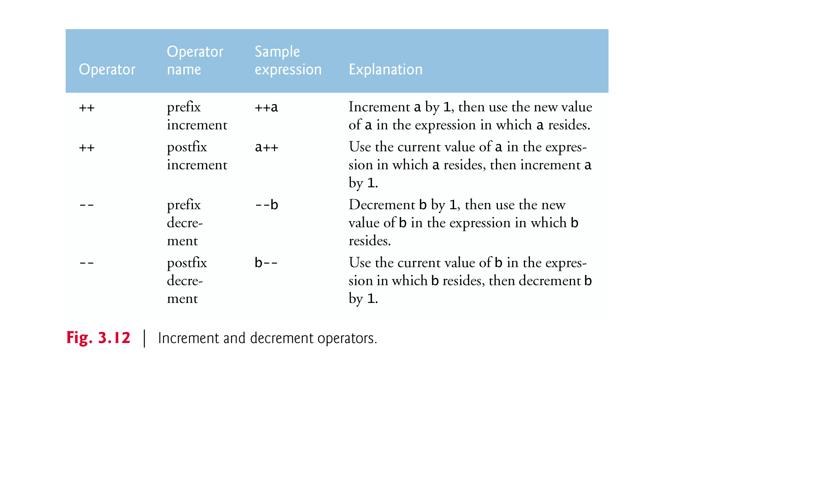


Slide 47
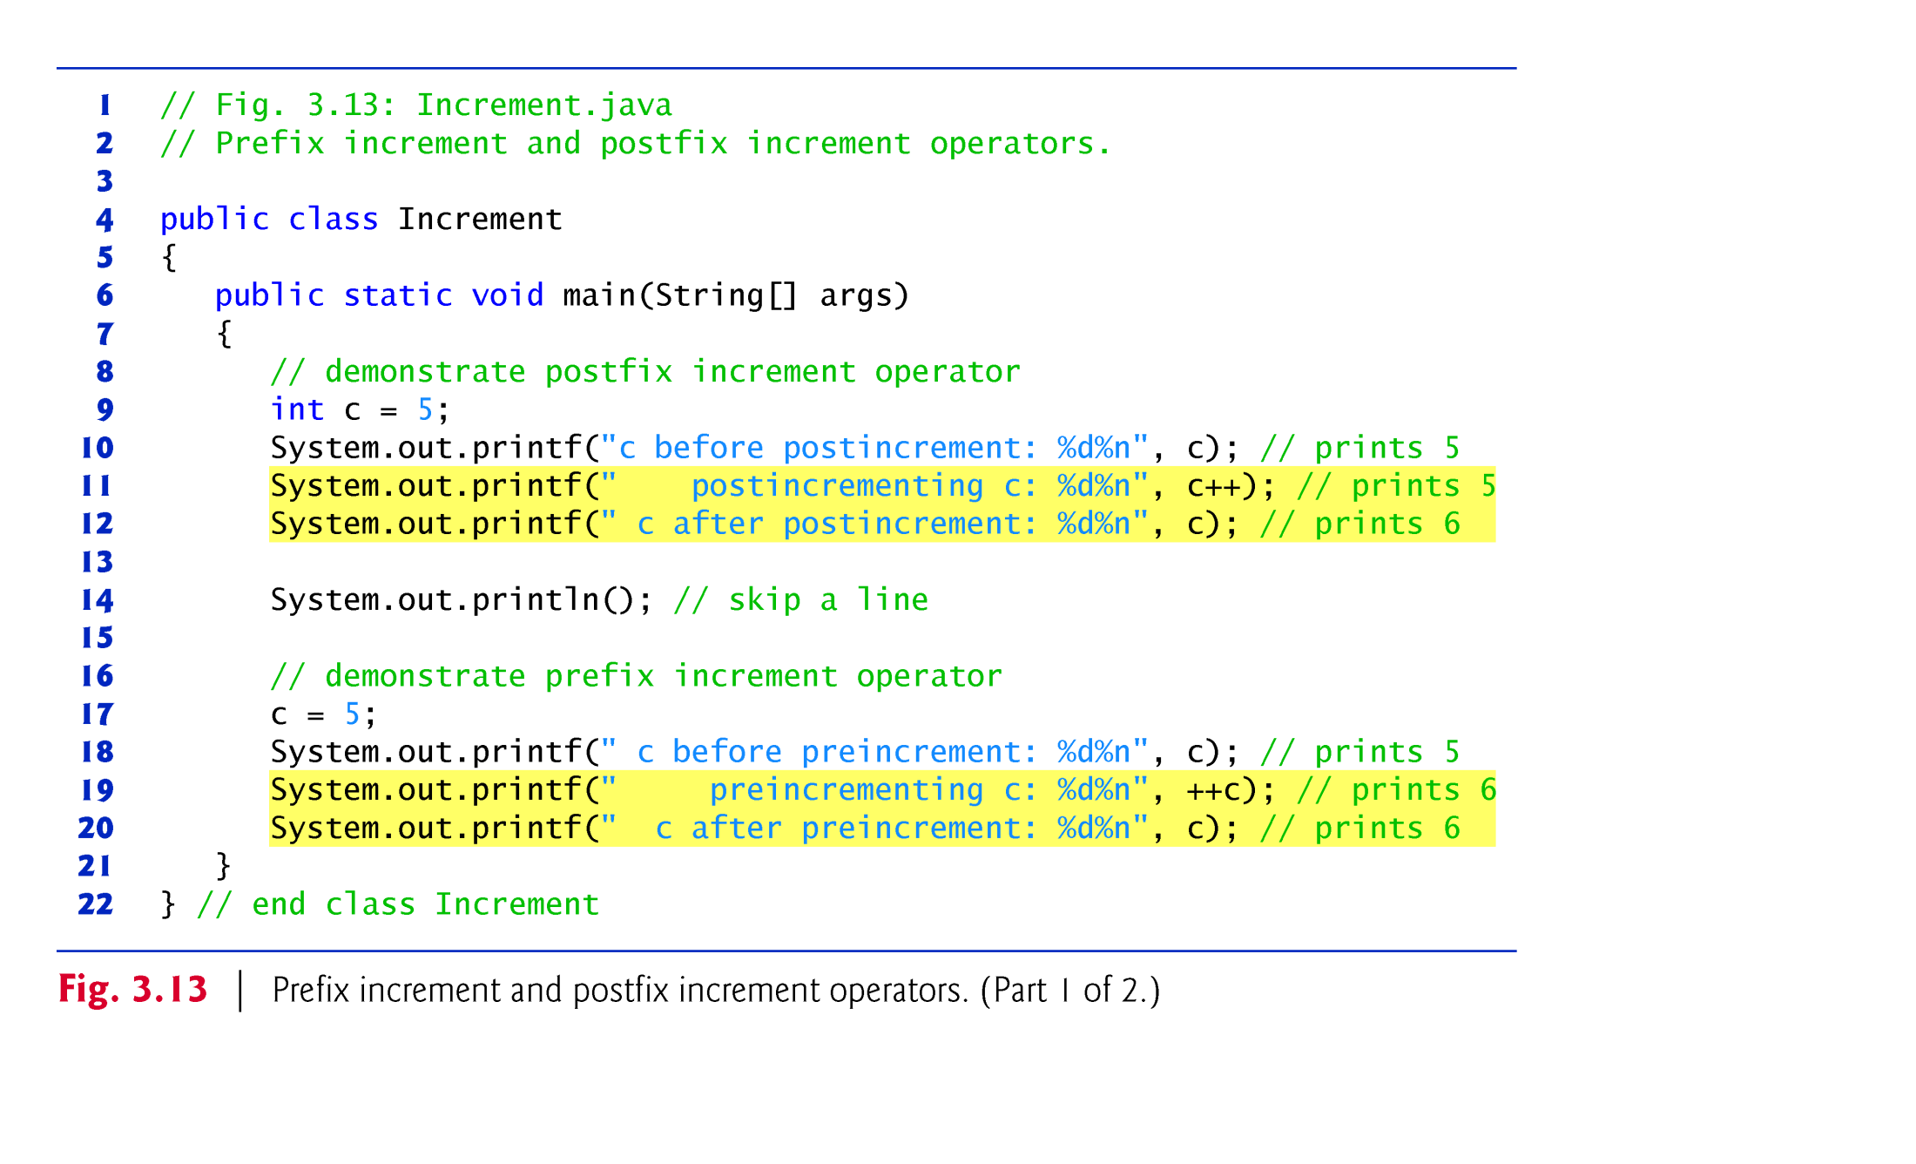

Slide 48
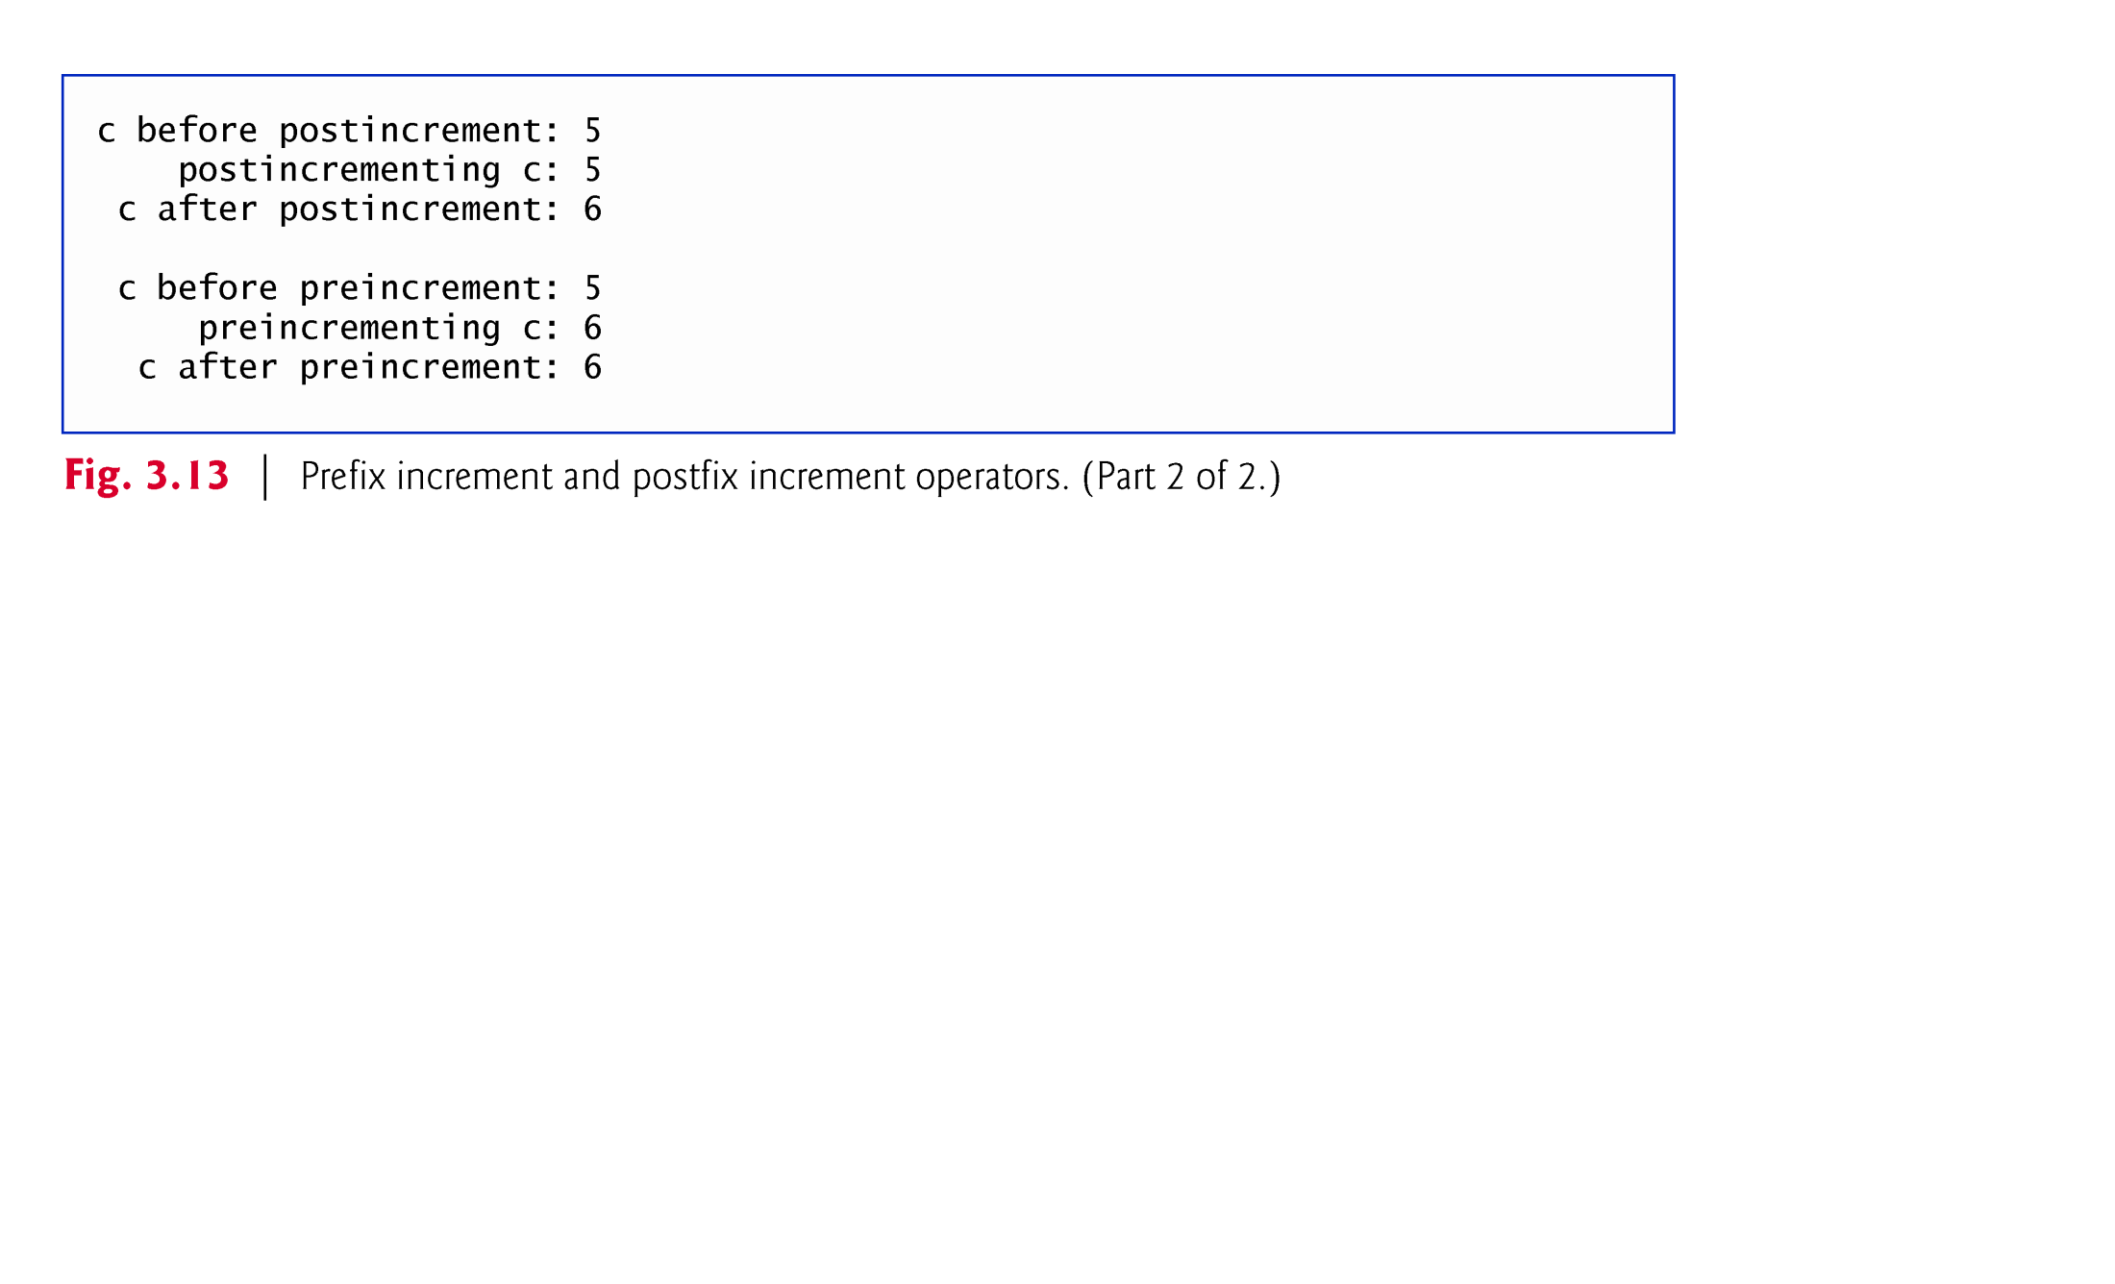
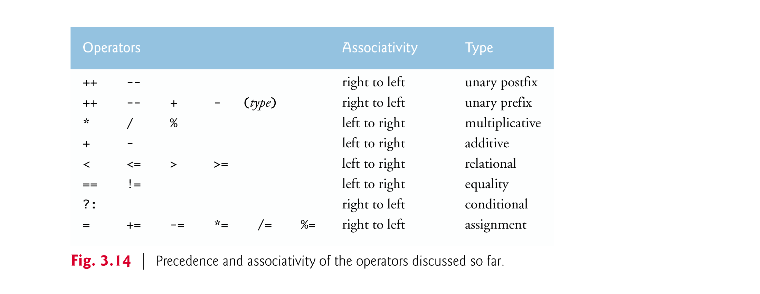

Slide 49
Appendix
Compiling Java Program from a terminal

Slide 50
2.2 Your First Program in Java: Printing a Line of Text (Cont.)
Compiling Your First Java Application
Open a command window and change to the directory where the program is stored.
Many operating systems use the command cd to change directories.
To compile the program, type
javac Welcome1.java
If the program contains no compilation errors, preceding command creates a.class file (known as the class file) containing the platform-independent Java bytecodes that represent the application.
When we use the java command to execute the application on a given platform, these bytecodes will be translated by the JVM into instructions that are understood by the underlying operating system.

Slide 51
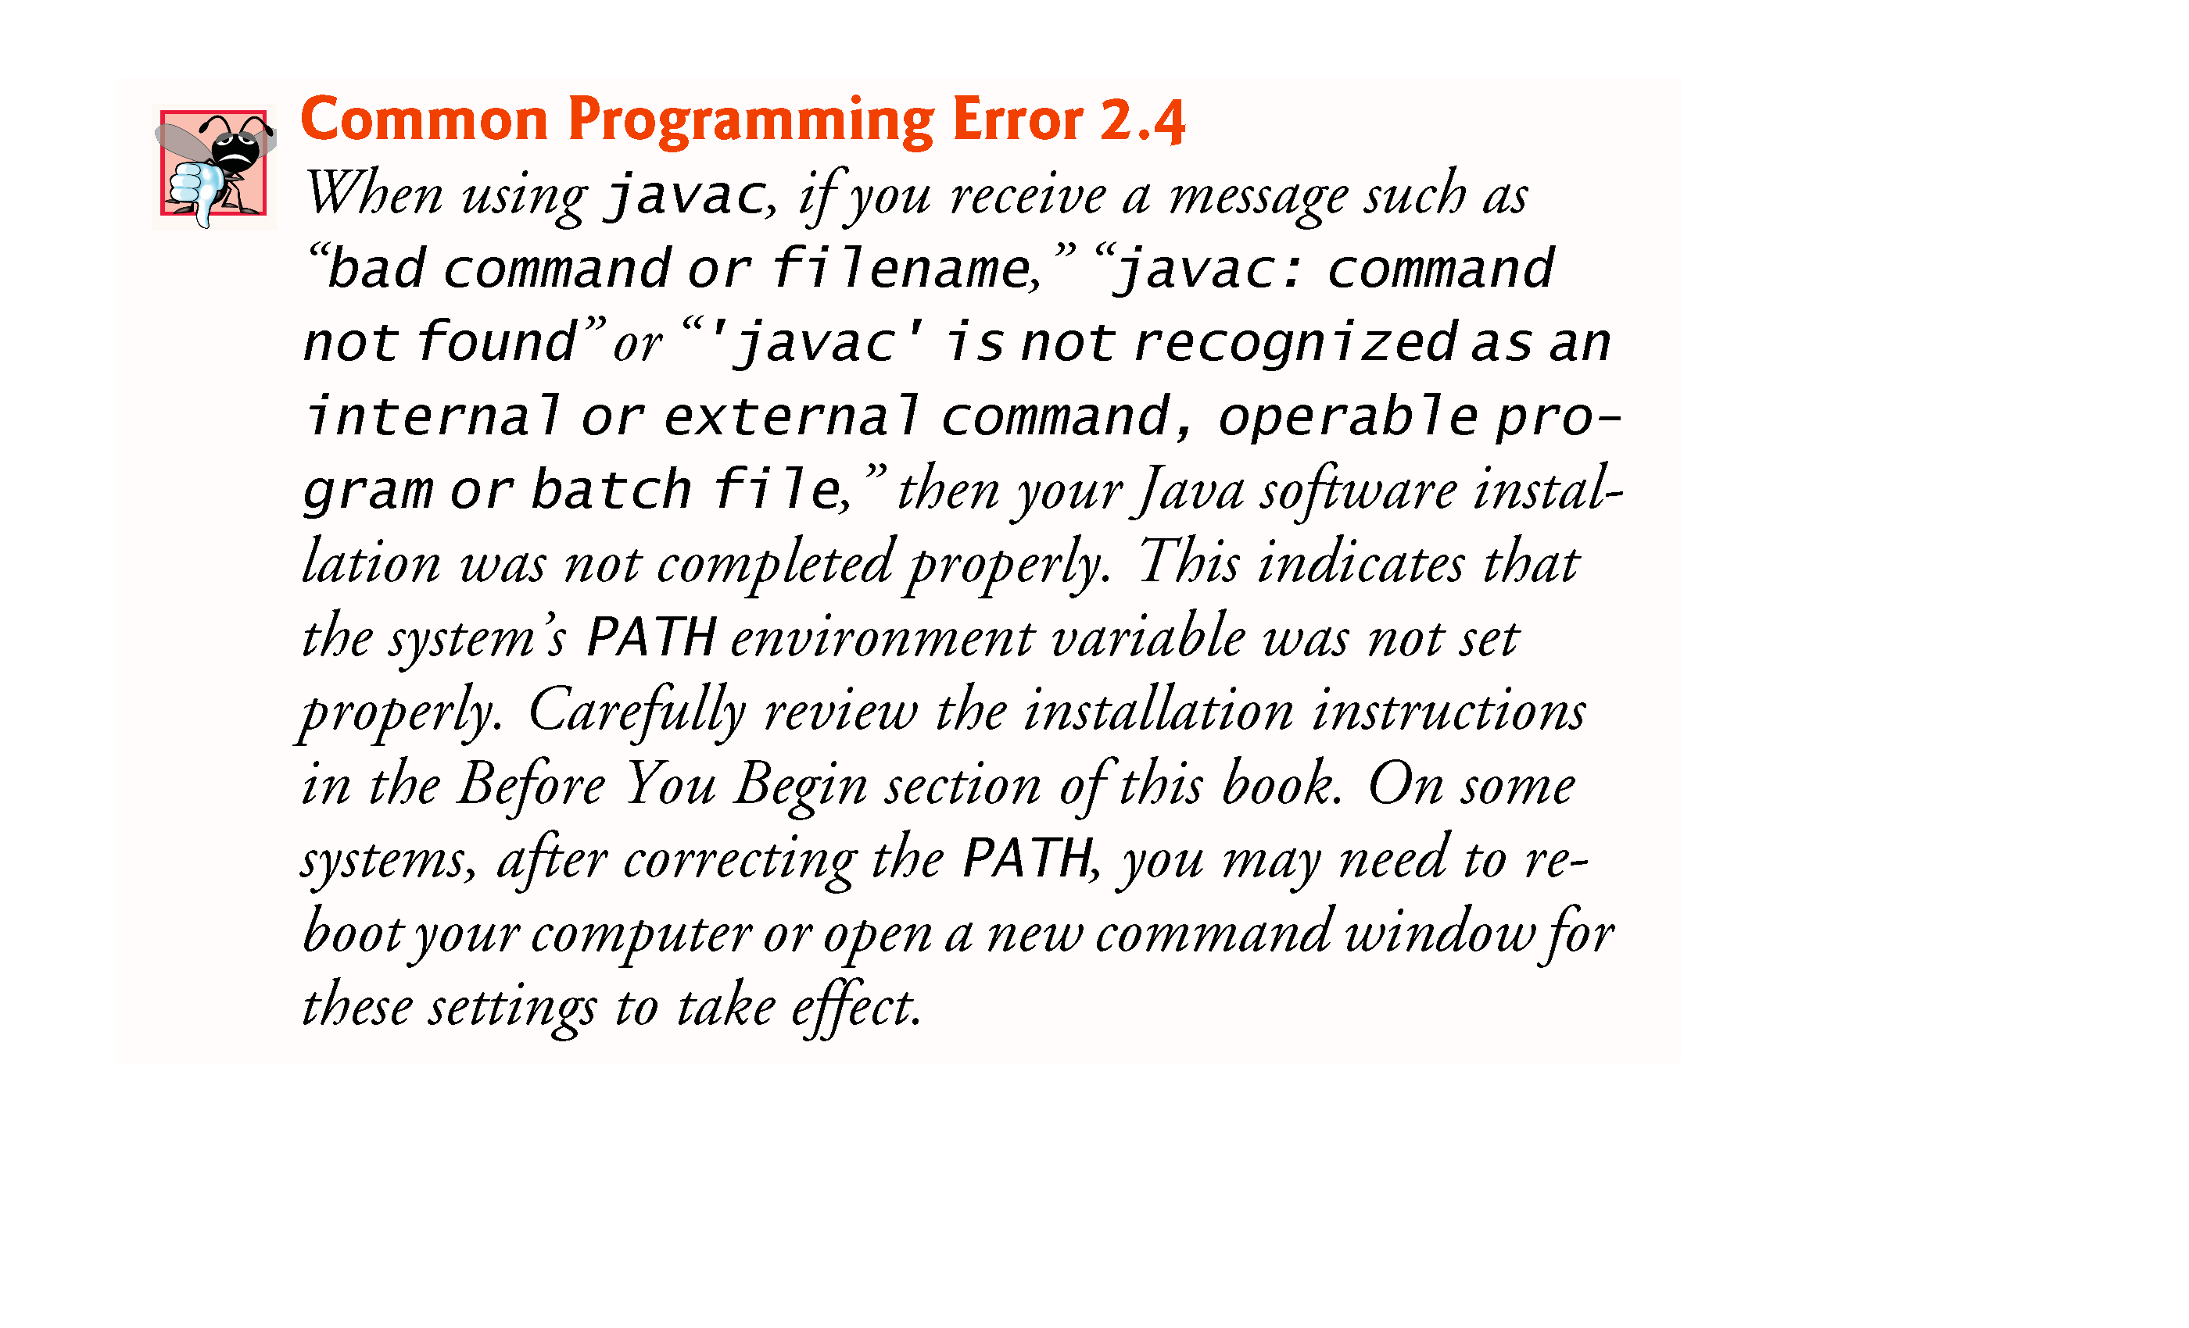

Slide 52
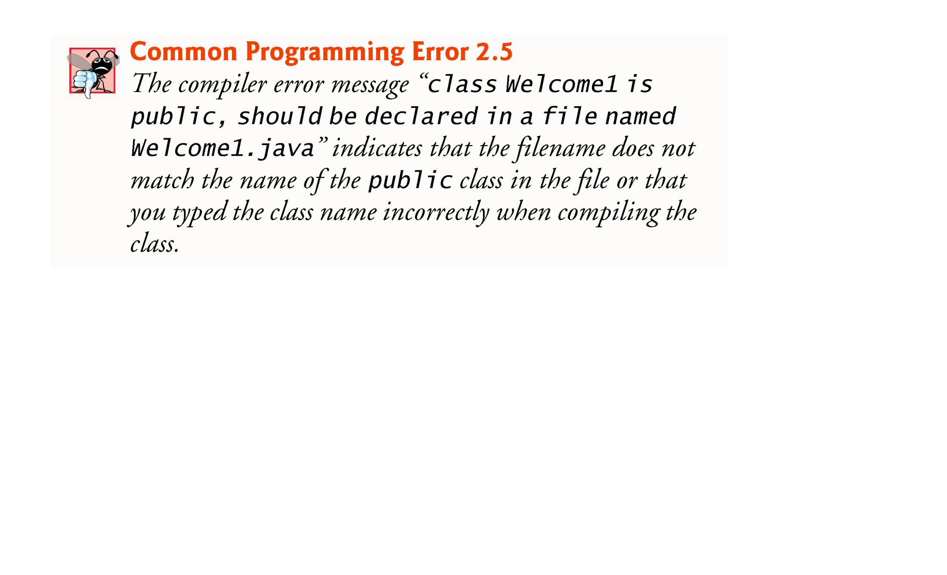

Slide 53
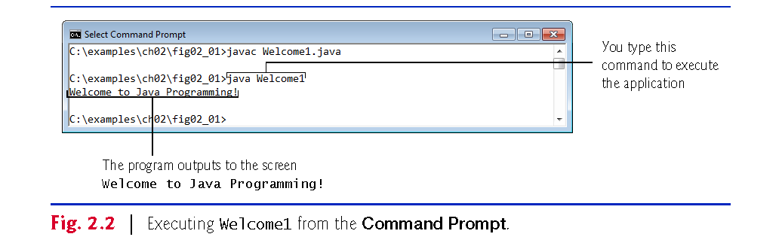
2.2 Your First Program in Java: Printing a Line of Text (Cont.)

